Slide 1
LaRC Spectrum Management
Lee Joyce
LaRC ALT RF Spectrum Manager

Slide 2
Topics
Why are we here?
What is required?
What functions do we provide?
Who are we?
Typical process steps
How do you contact us?

Slide 3
What Is Spectrum Management?
Spectrum management is the process of regulating the use of radio frequencies to promote efficient use and gain a net social benefit.
The art and science of managing the use of the radio spectrum is to minimize interference and ensure radio spectrum is used to its most efficient extent and benefit for the public.

Slide 4
Why Are We Here?
NASA is part of the overall US government spectrum coordination process that fulfills the US international obligations for RF spectrum management under the ITU.
NASA works through NTIA and not FCC

Slide 5
Why Are We Here?
FCC (Federal Communications Commission):
  The FCC is an independent agency that regulates non-Federal spectrum use.
  It oversees various aspects of telecommunications, including radio, television, wireless communication, broadband, and satellite services.
  The FCC sets rules, licenses spectrum, enforces regulations, and promotes competition in the communications industry.
  It is overseen by Congress and operates independently from the executive branch.
  The FCC ensures efficient and fair use of non-governmental spectrum resources.
NTIA (National Telecommunications and Information Administration):
  The NTIA is an executive branch agency responsible for authorizing Federal spectrum use.
  It serves as the President’s principal advisor on telecommunications policies.
  The NTIA coordinates and communicates the views of the Executive Branch regarding spectrum management.
  It ensures that Federal agencies use spectrum efficiently and effectively to meet their mission requirements.
  The NTIA plays a crucial role in national security, emergency communications, and other vital interests.
  It collaborates with the FCC to jointly manage the nation’s radio spectrum resources in the public interest

Slide 6
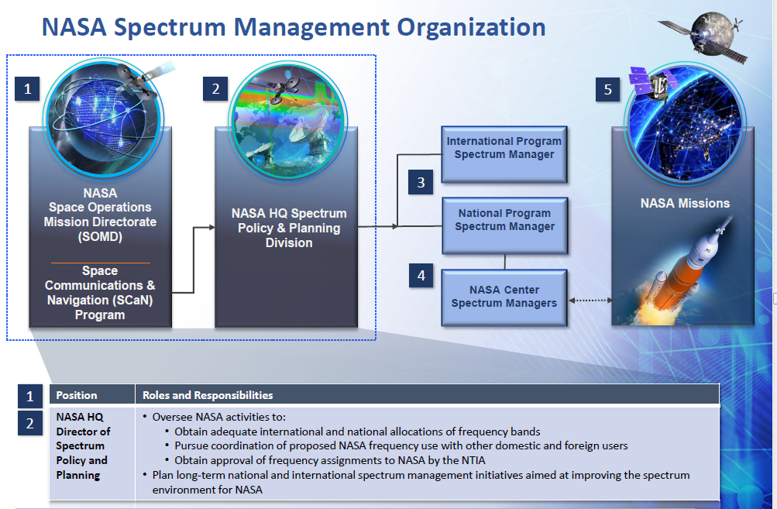

Slide 7
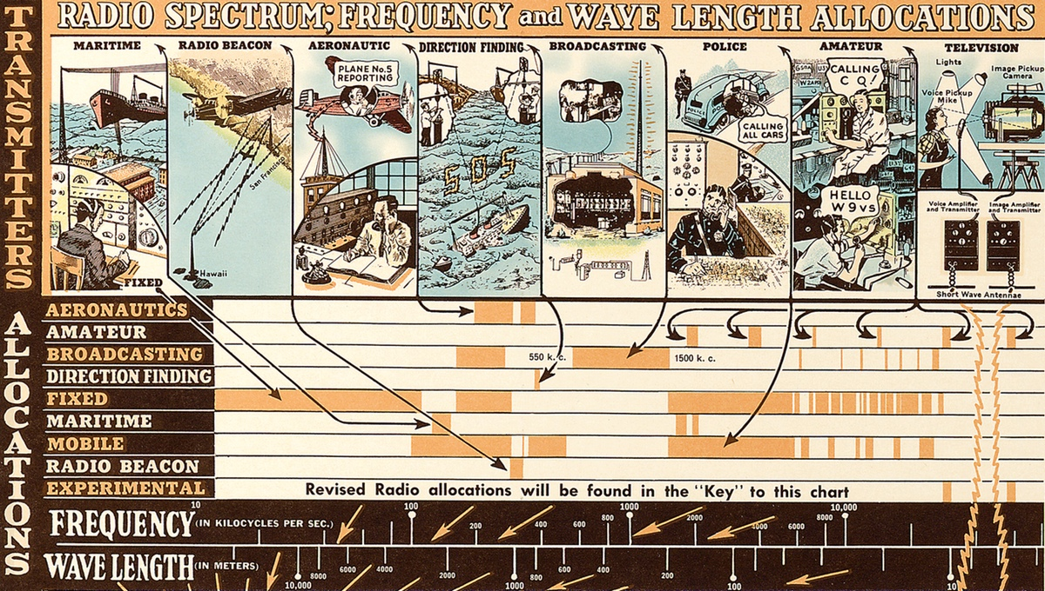
Why Are We Here?

Slide 8
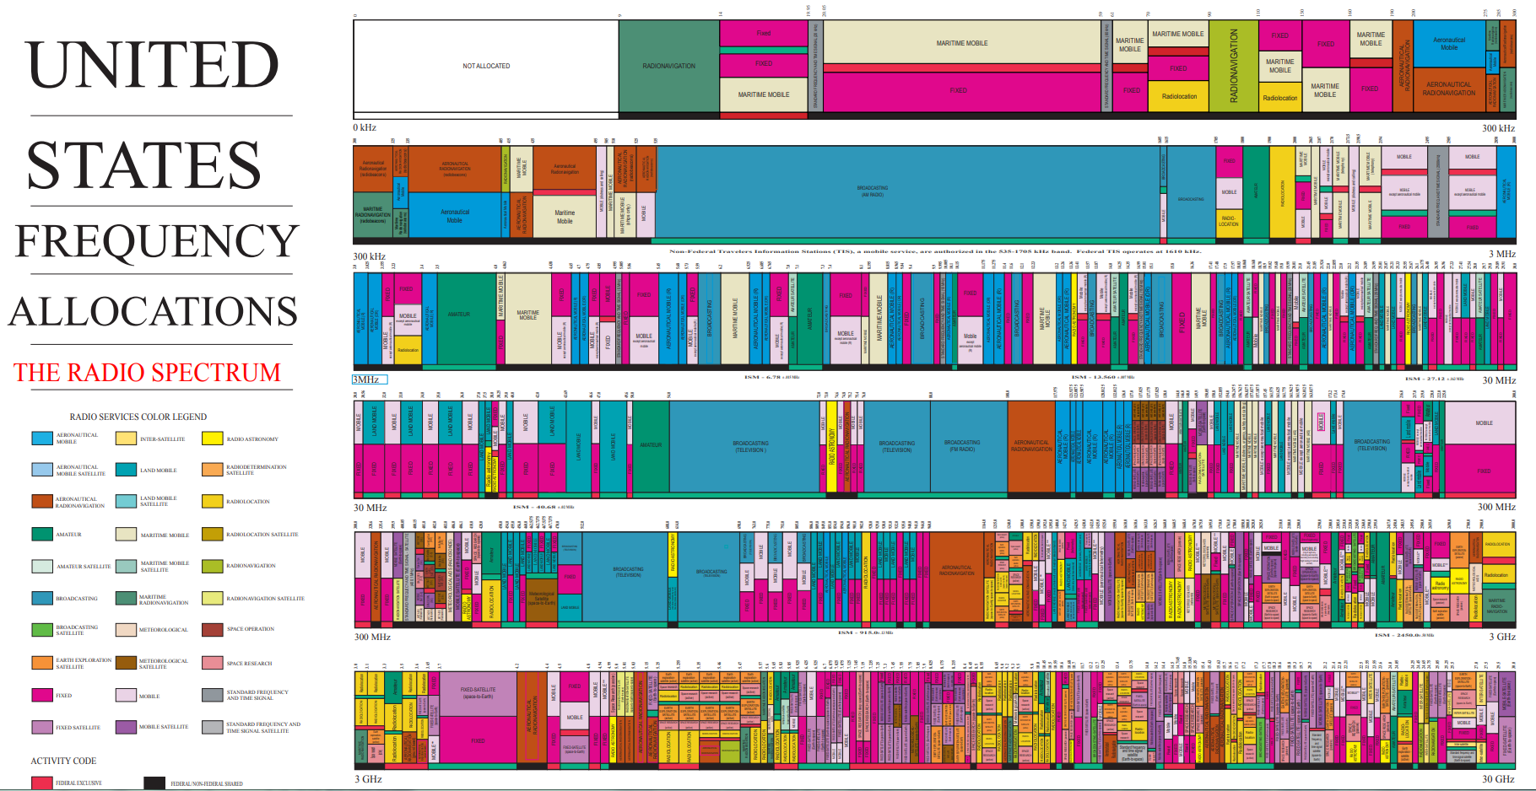
Why Are We Here?

Slide 9
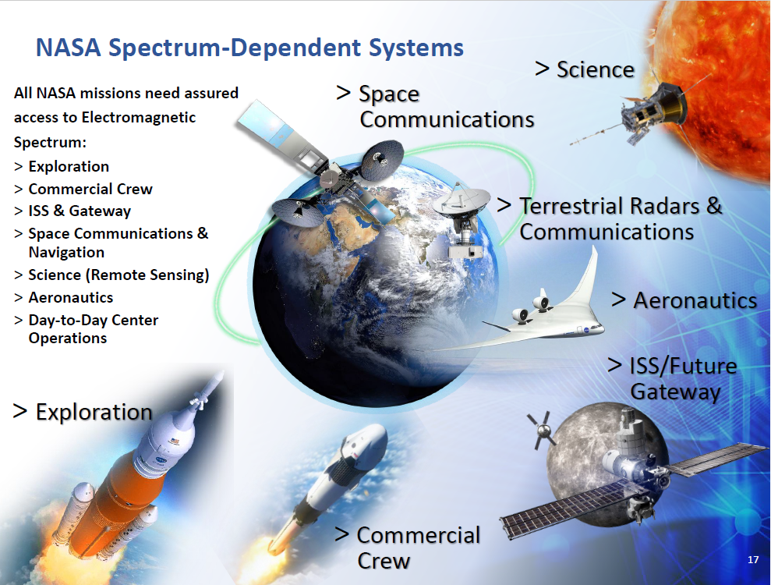

Slide 10
Why Are We Here?
To fulfill the national and international spectrum requirements as part of the federal government, NASA HQ and Centers have spectrum management offices to administer and coordinate the efforts of the Agency
Each Center has a Level 3 Spectrum Manager (SM) office to coordinate the activities on Center, with other Centers, and other spectrum users.

Slide 11
Why Are We Here?
NASA Governing Documents
  NPR 2570.1 governing missions, programs, and projects needing RF spectrum to properly adhere to spectrum guidelines as part of their engineering and fiscal requirements
  NPD 2570.5 stating that the Center shall ensure that all spectrum users on Center meet the requirements of the International Telecommunications Union (ITU), National Telecommunications and Information Administration (NTIA), and other regulations in their processes and design efforts

Slide 12
Why Are We Here?
LaRC Governing Documents
  LPR 2570.5 outlines activities by Branches and projects in letting the Spectrum Manager know current and future spectrum needs, activities using the RF spectrum and needing licensure/certification, interference issues, etc.
  CP-5511 – Frequency coordination for on-center ops
  CP-5512 – Requesting RFA and STA for “major” systems, i.e., those systems having potential impacts beyond Center boundaries such as radars or satellites, even CubeSats

Slide 13
What Is Required?
To Assist the Center in Meeting NPR 2570.1 and LPR 2570.5:
  LaRC Spectrum Manager Coordinates all the Radio Frequency (RF) spectrum requirements pertaining to activities and projects involving Langley Research Center (LaRC) with the Agency Spectrum Program Manager, in compliance with NPD 2570.5 and NPR 2570.1. Assigns experimental call signs for NASA radio nets, when applicable. Authorizes the operation of RF-emitting devices and equipment. Assists in resolving spectrum interference cases.

Slide 14
What Functions Do We Provide?
US Government
  Langley AFB & FAA frequency coordination
  NRAO interference prevention from LaRC
  Other Government Agencies frequency coordination, as required
NASA Agency Level
  National (primary) and International (secondary) Spectrum uses
  WFF cooperatively coordinate frequencies
  Other NASA Centers cooperatively coordinate frequencies, as needed.

Slide 15
What Functions Do We Provide?
Langley Center Level
  Frequency assessment and de-confliction, as needed
  Engineering and R&D Support for design reviews
  Flight Operations Support
  RF Interference Resolution
  SME Assistance for measurement and analysis; e.g., radio link budget analysis, RF device characterization

Slide 16
What Functions Do We Provide?
Spectrum Certification for devices
  If it emits RF, we need to be in the loop; Everything from office equipment through satellites and instruments (see LMS-CP-5511 and LMS-CP-5512)
  Start with the LF400 to detail the needs
  Note: Major systems need a System Review document
Assistance in resolving RF interference issues
Support for RF link analysis support
Support for RF-related measurements
Coordination with LaRC and local federal users, and regional emergency communications entities

Slide 17
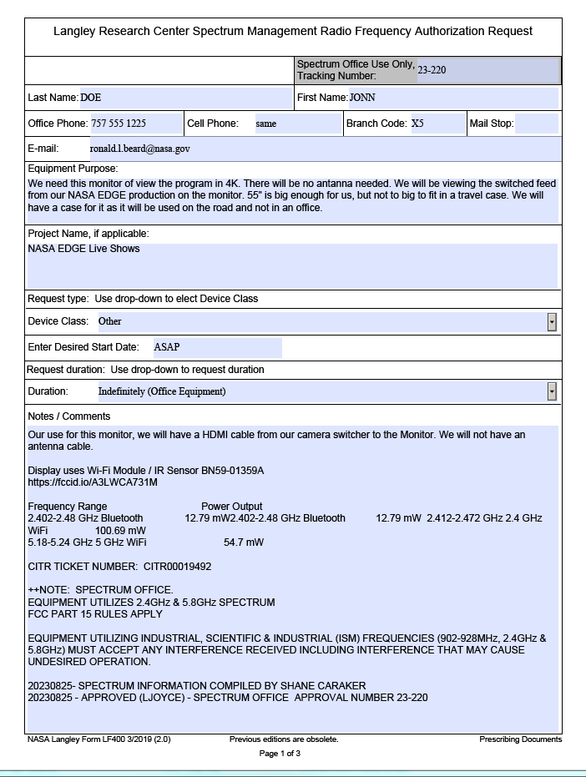
CITR Typical Process Steps
User completes LF400
User submits to Spectrum Manager for review
SM reviews LF400 and notes usage locations; looks for any potential conflicts
User or SM submits to Center IT for review if networking is impacted

Slide 18
LaRC Spectrum Office
Spectrum Manager –
Mr. Jay Ely, D3, 864-1868,
B2104:R127
Deputy Spectrum Manager –
Ms. Charmaine Franck, D3, 864-2028,
B2102:R299:c33
Alternate Spectrum Manager –
Mr. Lee Joyce (AMA), D408, 864-6737,
B2104:R127:c25 WB4WZI
Spectrum Technician –
Mr. Taylor Everard, D3,
B2104:R127:c26 KO6ATD

Slide 19
How Do You Find Us?
On the LaRC Web at https://osm.larc.nasa.gov/

Slide 20
SignOffPage
Questions?
Notes:
NASA Presentation Sign-Off Page

