Slide 1
LCSC Small Business Update
Robert Betts
NASA Office of Small Business Programs
Langley Research Center
February 2024

Slide 2
NASA Agency October - January FY24
Prime Goals vs. Actual Percentages
Data generated February 6, 2024 from SAM.GOV

Slide 3
Langley Research Center (LaRC) October - January FY24
Prime Goals vs. Actual Percentages
Data generated February 6, 2024 from SAM.GOV

Slide 4
UPCOMING OPPORTUNITIES
(https://www.hq.nasa.gov/office/procurement/forecast/)
Name of Procurement | NAICS Code | Set-Aside | Est. RFP/RFQ Release | Remarks
Langley Logistics Support Services (LSS) 2 | 541614 | 8(a) | 10/20/23 | 80LARC24R0001 Proposals due: 11/20/23 POC: Kimberly Wilson (Kimberly.C.Wilson@nasa.gov)
Langley Grounds Maintenance & Pest Control Support Services (LGMPCS) II | 561730 | 8(a) | TBD | RFP - 80LARC23R0010 Responses due 3/11/24 POC: LaRonda Davis-James (LARC-LGMPCSII@mail.nasa.gov)
Enterprise Geospatial Support Services (EGSS) | 541330 | TBD | TBD | POC: Will Peeples (william.t.peeples@nasa.gov)
Institutional Safety | 541690 | TBD | TBD | Center Safety and Fire for LaRC, JSC, & GSFC POC: Kenneth Poast (kenneth.i.poast@nasa.gov)
NASA Small Business Innovation Research (SBIR)/Small Business Technology Transfer (STTR) – Phase I | 541715 | SB | 01/09/2024 | Proposals due: 03/11/2024 https://www.nasa.gov/sbir_sttr/

Slide 5
Upcoming Learning Opportunities
Date | Topic | Presenter | Comments/Registration
February 21 | Learning Series: NASA HBCU Opportunities | NASA OSBP | https://www.nasa.gov/osbp/learning-series
March 20 | Learning Series: Women Changemakers and Small Business Success at NASA | NASA OSBP | https://www.nasa.gov/osbp/learning-series
April 17 | Learning Series: How to Secure Federal Government Funding | NASA OSBP | https://www.nasa.gov/osbp/learning-series
May 15 | Learning Series: Successful Small Business Stories at NASA | NASA OSBP | https://www.nasa.gov/osbp/learning-series
June 19 | Learning Series: Annual Small Business Town Hall | NASA OSBP | https://www.nasa.gov/osbp/learning-series
July 17 | Learning Series: IT Opportunities at NASA | NASA OSBP | https://www.nasa.gov/osbp/learning-series
August 21 | Learning Series: NASA FFRDC Opportunities | NASA OSBP | https://www.nasa.gov/osbp/learning-series

Slide 6
Upcoming Outreach Opportunities
Date | Topic | Host | Location | Comments/Registration
February 27-28 | Hampton Roads Small Business Conference | Society of American Military Engineers (SAME) | Virginia Beach Convention Center | https://www.same.org/event/small-business-conference/
March 6 | GSA Virtual Meet & Match: Supporting the Success of Women-Owned Small Businesses | US Women’s Chamber of Commerce (USWCC) | Virtual | https://www.uswcc.org/events/gsa-2024
March 21 | 37th Marshall Small Business Alliance | NASA MSFC SB Office | Hybrid | https://www.eventbrite.com/e/37th-marshall-small-business-alliance-tickets-796298529337?aff=oddtdtcreator
March 26-27 April 4 | National Small Business Federal Contracting Summit | DC Spring 2024 | USWCC | Hybrid | In-person (Wash DC) – March 26-27 Virtual Matchmaking – April 4 https://www.uswcc.org/events/national-small-business-federal-contracting-summit-spring-2024-dc-area-hybrid/
April 5 | NASA and Partners Small Business and HBCU Summit: Create, Connect & Collaborate | NASA OSBP | Howard University | TBA
April 16-18 | NASA HBCU/MSI Technology Infusion Road Tour at Clark Atlanta University | NASA OSBP & MUREP | Atlanta, GA | TBA

Slide 7
Contact Information & Links
Robert Betts
Small Business Specialist
NASA Office of Small Business Programs – IT Procurement Office & Langley Research Center
Tel: (757) 864-6074
Email: larc-SmallBusiness@mail.nasa.gov
NASA LaRC SB Marketing Guide: https://www.nasa.gov/osbp/about-nasa-centers/#langley
Website: www.nasa.gov/osbp
NASA Vendor Database: https://apps.nasa.gov/nvdb/
NASA Partnerships: www.nasa.gov/partnerships
NASA Tech Transfer: http://technology.nasa.gov
NASA SBIR/STTR: https://www.nasa.gov/sbir_sttr/
2023 NASA Langley Research Center Annual Report: https://oh.larc.nasa.gov/oh/annual-report/2023/
NASA Spinoff 2023: https://spinoff.nasa.gov/sites/default/files/2023-01/NASA-Spinoff-2023.pdf

Slide 8
Backup Slides

Slide 9
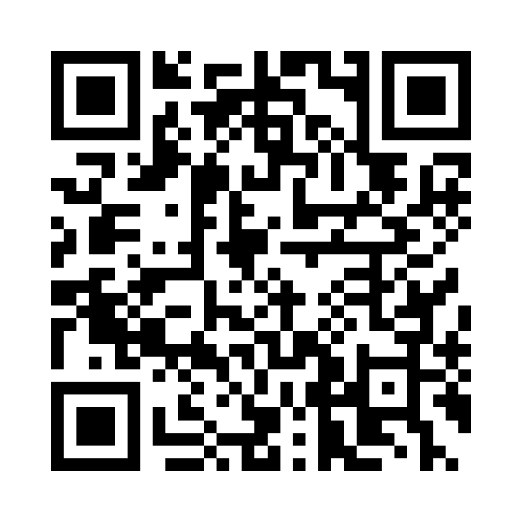
NASA Vendor Database QR Code
Tips for QR code use:
  Handouts
  Small Business presentations
  Email signature
  Surveys
Warning
  Do not oversaturate QR code use
Website - https://apps.nasa.gov/nvdb/

Slide 10
Where to find opportunities
Source | Website | Comments
SAM | https://sam.gov/ | Federal contract opportunities website
NASA Acquisition Forecast | https://www.hq.nasa.gov/office/procurement/forecast/ | Agency-wide acquisition forecast
NASA Active Contract List | https://www.nasa.gov/osbp/active-contract-listings/ | Current NASA contracts. Also available on the NASA OSBP Mobile App
Small Business Administration Subcontracting Network (SubNet) | https://subnet.sba.gov/client/dsp_Landing.cfm | Federal subcontracting opportunities
NASA Vendor Database (NVDB) | https://apps.nasa.gov/nvdb/ | Register to share capabilities and receive NASA Procurement notices. NVDB is a market research tool for Acquisition personnel.
NASA Mentor Protégé | https://www.nasa.gov/osbp/mentor-protege-program/ | NASA MPP encourages NASA prime contractors to assist eligible Protégés, thereby enhancing the Protégés’ capabilities to perform on NASA contracts and subcontracts, fostering the establishment of long-term business relationships between these entities and NASA prime contractors, and increasing the overall number of these entities that receive NASA contract and subcontract awards
NASA Solicitation and Proposal Integrated Review and Evaluation System (NSPIRES) | https://nspires.nasaprs.com/external/ | Research opportunities in science and technology
NASA Small Business Innovation Research/Small Business Technology Transfer (SBIR/STTR) | https://www.nasa.gov/sbir_sttr/ | Opportunities for small, high technology companies and research institutions to participate in Federal Government sponsored R&D efforts in key technology areas
NASA TechPort | https://techport.nasa.gov/ | Showcases NASA’s portfolio of active and completed technology projects.
NASA Technology Transfer 2023/2024 Software Catalog | https://software.nasa.gov/ | NASA's Software Catalog offers hundreds of new software programs you can download for free to use in a wide variety of technical applications.

Slide 11
Where to find SB Assistance
Source | Website
SBA – Richmond District Office | https://www.sba.gov/district/virginia?utm_medium=email&utm_source=govdelivery
Virginia APEX Accelerators (formally PTAC) | https://virginiaptac.org
Service Corps of Retired Executives (SCORE) | https://www.score.org/?utm_medium=email&utm_source=govdelivery
Veteran Business Outreach Center (VBOC) | https://www.odu.edu/iie/vboc?utm_medium=email&utm_source=govdelivery
Virginia Small Business Development Center (SBDC) | https://www.virginiasbdc.org/business-recovery-center/
Women’s Business Center (WBC) - ODU | https://ww1.odu.edu/iie/wbc
Women’s Business Center (WBC) of Richmond | https://theinstitutenc.org/WBCRichmond/

