Slide 1
LCSC Small Business Update
Robert Betts
NASA Office of Small Business Programs
Langley Research Center
January 2024

Slide 2
NASA Agency October - December FY24
Prime Goals vs. Actual Percentages
Data generated January 5, 2024 from SAM.GOV
Note: NASA has yet to receive the official goaling letter from SBA.

Slide 3
Langley Research Center (LaRC) October - December FY24
Prime Goals vs. Actual Percentages
Data generated January 5, 2024 from SAM.GOV

Slide 4
FY23 LaRC SB industry Awards
LB Prime Contractor of the Year: Nokia of America Corporation
Mentor-Protégé Agreement of the Year: Jacobs Technology and Analytical Services & Materials (AS&M)
Congratulations to the LaRC Winners!

Slide 5
UPCOMING OPPORTUNITIES
(https://www.hq.nasa.gov/office/procurement/forecast/)
Name of Procurement | NAICS Code | Set-Aside | Est. RFP/RFQ Release | Remarks
Langley Logistics Support Services (LSS) 2 | 541614 | 8(a) | 10/20/23 | 80LARC24R0001 Proposals due: 11/20/23 POC: Kimberly Wilson (Kimberly.C.Wilson@nasa.gov)
Langley Grounds Maintenance & Pest Control Support Services (LGMPCS) II | 561730 | 8(a) | TBD | DRFP - 80LARC23R0010 Responses due 10/23/23 POC: LaRonda Davis-James (LARC-LGMPCSII@mail.nasa.gov)
Enterprise Geospatial Support Services | 541330 | TBD | TBD | POC: Will Peeples (william.t.peeples@nasa.gov)
Institutional Safety | 541690 | TBD | TBD | Center Safety and Fire for LaRC, JSC, & GSFC POC: Kenneth Poast (kenneth.i.poast@nasa.gov)
NASA Small Business Innovation Research (SBIR)/Small Business Technology Transfer (STTR) – Phase I | 541715 | SB | 01/09/2024 | Proposals due: 03/11/2024 https://sbir.nasa.gov/solicitations

Slide 6
Upcoming Learning Opportunities
Date | Topic | Presenter | Comments/Registration
January 22 | Webinar: How to Make Money as a Government Contractor | VA APEX | https://virginiaptac.ecenterdirect.com/events/4201
January 23 | How To Effectively Represent Your Brand (Your Business Introduction!) | VA SBSD | https://www.eventbrite.com/e/how-to-effectively-represent-your-brand-your-business-introduction-tickets-758986167057?
January 25 | Finding Government ﻿Contracting Opportunities (Virginia Beach) | VA APEX | In person: 140 Independence Blvd, Virginia Beach https://virginiaptac.ecenterdirect.com/events/4185
January 30 | Proposal Development (Hampton) | VA APEX | In person: 1 Franklin St, Hampton https://virginiaptac.ecenterdirect.com/events/4187
January 31 | Webinar: Navigating the FAR/DFARS: The Most Confusing and Little-Known Clauses | VA APEX | https://virginiaptac.ecenterdirect.com/events/4093
February 16 | Learning Series: NASA HBCU Opportunities | NASA OSBP | https://www.nasa.gov/osbp/learning-series
March 20 | Learning Series: Women Changemakers and Small Business Success at NASA | NASA OSBP | https://www.nasa.gov/osbp/learning-series
April 17 | Learning Series: How to Secure Federal Government Funding | NASA OSBP | https://www.nasa.gov/osbp/learning-series
May 15 | Learning Series: Successful Small Business Stories at NASA | NASA OSBP | https://www.nasa.gov/osbp/learning-series
June 19 | Learning Series: Annual Small Business Town Hall | NASA OSBP | https://www.nasa.gov/osbp/learning-series
July 17 | Learning Series: IT Opportunities at NASA | NASA OSBP | https://www.nasa.gov/osbp/learning-series
August 21 | Learning Series: NASA FFRDC Opportunities | NASA OSBP | https://www.nasa.gov/osbp/learning-series

Slide 7
Upcoming Outreach Opportunities
Date | Topic | Host | Location | Comments/Registration
January 18-19 | 1st Annual Hampton Roads Small Business Navy Expo | US Navy | Hampton Roads Convention Center | https://virginiaptac.ecenterdirect.com/events/4212
January 25 | NASA Small Business Outreach Event and Networking | NASA OSBP | Virtual | https://www.nasa.gov/osbp/osbp-outreach-events/
February 27-28 | Hampton Roads Small Business Conference | Society of American Military Engineers (SAME) | Virginia Beach Convention Center | https://www.same.org/event/small-business-conference/
March 26-27 April 4 | National Small Business Federal Contracting Summit | DC Spring 2024 | US Women’s Chamber of Commerce (USWCC) | Hybrid | In-person (Wash DC) – March 26-27 Virtual Matchmaking – April 4 https://www.uswcc.org/events/national-small-business-federal-contracting-summit-spring-2024-dc-area-hybrid/

Slide 8
Contact Information & Links
Robert Betts
Small Business Specialist
NASA Office of Small Business Programs – IT Procurement Office & Langley Research Center
Tel: (757) 864-6074
Email: larc-SmallBusiness@mail.nasa.gov
NASA LaRC SB Marketing Guide: https://www.nasa.gov/osbp/about-nasa-centers/#langley
Website: www.nasa.gov/osbp
NASA Vendor Database: https://apps.nasa.gov/nvdb/
NASA Partnerships: www.nasa.gov/partnerships
NASA Tech Transfer: http://technology.nasa.gov
NASA SBIR/STTR: www.sbir.nasa.gov
2022 NASA Langley Research Center Annual Report: https://oh.larc.nasa.gov/oh/annual-report/2022/
NASA Spinoff 2023: https://spinoff.nasa.gov/sites/default/files/2023-01/NASA-Spinoff-2023.pdf

Slide 9
Backup Slides

Slide 10
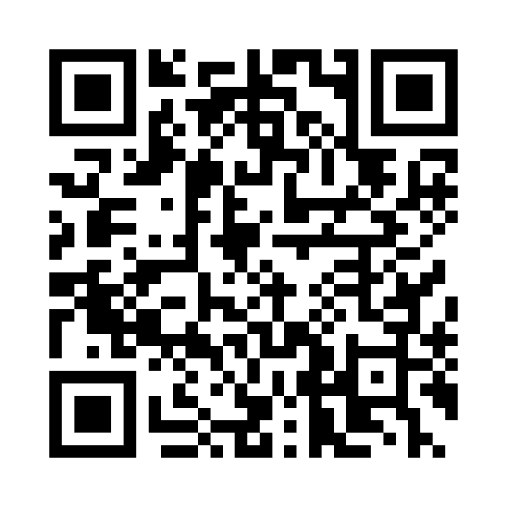
NASA Vendor Database QR Code
Tips for QR code use:
  Handouts
  Small Business presentations
  Email signature
  Surveys
Warning
  Do not oversaturate QR code use
Website - https://apps.nasa.gov/nvdb/

Slide 11
Where to find opportunities
Source | Website | Comments
SAM | https://sam.gov/ | Federal contract opportunities website
NASA Acquisition Forecast | https://www.hq.nasa.gov/office/procurement/forecast/ | Agency-wide acquisition forecast
NASA Active Contract List | www.nasa.gov/osbp | Current NASA contracts. Also available on the NASA OSBP Mobile App
Small Business Administration Subcontracting Network (SubNet) | https://eweb1.sba.gov/subnet/client/dsp_Landing.cfm | Federal subcontracting opportunities
NASA Vendor Database (NVDB) | https://apps.nasa.gov/nvdb/ | Register to share capabilities and receive NASA Procurement notices. NVDB is a market research tool for Acquisition personnel.
NASA Mentor Protégé | https://osbp.nasa.gov/mpp/index.html | NASA MPP encourages NASA prime contractors to assist eligible Protégés, thereby enhancing the Protégés’ capabilities to perform on NASA contracts and subcontracts, fostering the establishment of long-term business relationships between these entities and NASA prime contractors, and increasing the overall number of these entities that receive NASA contract and subcontract awards
NASA Solicitation and Proposal Integrated Review and Evaluation System (NSPIRES) | https://nspires.nasaprs.com/external/ | Research opportunities in science and technology
NASA Small Business Innovation Research/Small Business Technology Transfer (SBIR/STTR) | https://sbir.gsfc.nasa.gov/ | Opportunities for small, high technology companies and research institutions to participate in Federal Government sponsored R&D efforts in key technology areas
TechPort | https://techport.nasa.gov/ | Showcases NASA’s portfolio of active and completed technology projects.
NASA Technology Transfer 2023/2024 Software Catalog | https://software.nasa.gov/ | NASA's Software Catalog offers hundreds of new software programs you can download for free to use in a wide variety of technical applications.

Slide 12
Where to find Assistance
Source | Website
SBA – Richmond District Office | https://www.sba.gov/district/virginia?utm_medium=email&utm_source=govdelivery
Virginia APEX Accelerators (formally PTAC) | https://virginiaptac.org
Service Corps of Retired Executives (SCORE) | https://www.score.org/?utm_medium=email&utm_source=govdelivery
Veteran Business Outreach Center (VBOC) | https://www.odu.edu/iie/vboc?utm_medium=email&utm_source=govdelivery
Virginia Small Business Development Center (SBDC) | https://www.virginiasbdc.org/business-recovery-center/
Women’s Business Center (WBC) - ODU | https://www.odu.edu/iie/wbc?utm_medium=email&utm_source=govdelivery
Women’s Business Center (WBC) of Richmond – The Institute and Virginia Union University (VUU) | https://theinstitutenc.org/WBCRichmond/

