Slide 1
LCSC Small Business Update
Robert Betts
NASA Office of Small Business Programs
Langley Research Center
November 2023

Slide 2
NASA Agency October - September FY23 Prime Goals vs. Actual Percentages Data generated October 17, 2023 from SAM.GOV

Slide 3
Langley Research Center (LaRC) October - September FY23 Prime Goals vs. Actual Percentages Data generated October 17, 2023 from SAM.GOV

Slide 4
UPCOMING OPPORTUNITIES
(https://www.hq.nasa.gov/office/procurement/forecast/)
Name of Procurement | NAICS Code | Set-Aside | Est. RFP/RFQ Release | Remarks
Langley Logistics Support Services (LSS) 2 | 541614 | 8(a) | 10/20/23 | 80LARC24R0001 Proposals due: 11/20/23 POC: Kimberly Wilson (Kimberly.C.Wilson@nasa.gov)
Langley Grounds Maintenance & Pest Control Support Services (LGMPCS II) | 561730 | 8(a) | TBD | DRFP - 80LARC23R0010 Responses due 10/23/23 POC: LaRonda Davis-James (LARC-LGMPCSII@mail.nasa.gov)
Glenn-Langley Administrative Support Services (GLASS) | 561111 | 8(a) | TBD | POC: Lindsay Rogers (Lindsay.m.rogers@nasa.gov)
Enterprise Geospatial Support Services | 541330 | TBD | TBD | POC: Will Peeples (william.t.peeples@nasa.gov)
Institutional Safety - Center Safety and Fire for LaRC, JSC, & GSFC | 541690 | TBD | TBD | POC: Kenneth Poast (kenneth.i.poast@nasa.gov)
Use of an Available Research Facility at NASA Langley Research Center | N/A | N/A | N/A | Responses due 12/30/23 POC – Lori Brown hq-realestate@mail.nasa.gov

Slide 5
Upcoming Learning Opportunities
Date | Topic | Presenter | Comments/Registration
November 29 | Break Through Barriers and Hit Your Mark As A Leader | VA SBSD | https://www.eventbrite.com/e/break-through-barriers-and-hit-your-mark-as-a-leader-tickets-730474969297
December 13 | Learning Series: Programs and Resources to Help You Do Business with the Federal Government | NASA OSBP | https://www.nasa.gov/osbp/learning-series
December 14 | SWaM Certification Application Info Session | VA SBSD | https://www.eventbrite.com/e/swam-certification-application-info-session-tickets-751795168587?aff=erelexpmlt
December 21 | One-on-One Business Counseling (Eastern Virginia Region) | VA SBSD | https://www.eventbrite.com/e/one-on-one-business-counseling-eastern-virginia-region-registration-754673778587?
January 17 | Learning Series: How Best to Market to NASA | NASA OSBP | https://www.nasa.gov/osbp/learning-series
January 23 | How To Effectively Represent Your Brand (Your Business Introduction!) | VA SBSD | https://www.eventbrite.com/e/how-to-effectively-represent-your-brand-your-business-introduction-tickets-758986167057?
February 16 | Learning Series: NASA HBCU Opportunities | NASA OSBP | https://www.nasa.gov/osbp/learning-series

Slide 6
Upcoming Outreach Opportunities
Date | Topic | Host | Location | Comments/Registration
December 5-6 | Tri-State Procurement Technical Assistance Centers (PTAC) Mega Matchmaker | NY/PA/OH PTACs | Virtual | https://www.tri-state-ptac-mega-matchmaker.com
January 18-19 | 1st Annual Hampton Roads Small Business Navy Expo | US Navy | Hampton Roads Convention Center | https://virginiaptac.ecenterdirect.com/events/4212
January 25 | NASA Small Business Outreach Event and Networking | NASA OSBP | Virtual | https://www.nasa.gov/osbp/osbp-outreach-events/

Slide 7
Miscellaneous
New NASA LaRC Small Business Marketing Guide Link (https://www.nasa.gov/osbp/about-nasa-centers/#langley)
OSBP Mobile App has been updated
User-friendly tool to learn how to do business with NASA and have all the required resources right at your fingertips
Key features:
Allows users to easily contact NASA Center Small Business Specialists
View Active Contract Listings
Find upcoming networking events
Available for iOS and Android devices

Slide 8
Contact Information & Links
Robert Betts
Small Business Specialist
NASA Office of Small Business Programs – IT Procurement Office & Langley Research Center
Tel: (757) 864-6074
Email: larc-SmallBusiness@mail.nasa.gov
NASA LaRC SB Marketing Guide: https://www.nasa.gov/osbp/about-nasa-centers/#langley
Website: www.nasa.gov/osbp
NASA Vendor Database: https://apps.nasa.gov/nvdb/
NASA Partnerships: www.nasa.gov/partnerships
NASA Tech Transfer: http://technology.nasa.gov
NASA SBIR/STTR: www.sbir.nasa.gov
2022 NASA Langley Research Center Annual Report: https://oh.larc.nasa.gov/oh/annual-report/2022/
NASA Spinoff 2023: https://spinoff.nasa.gov/sites/default/files/2023-01/NASA-Spinoff-2023.pdf

Slide 9
Backup Slides

Slide 10
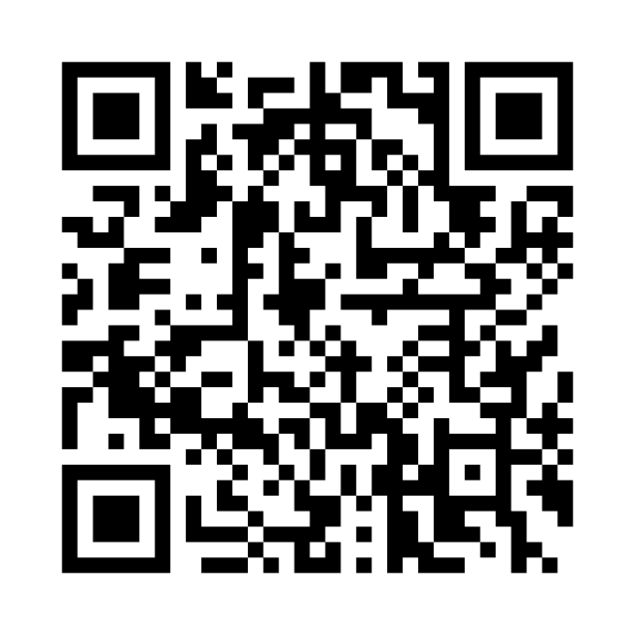
NASA Vendor Database QR Code
Tips for QR code use:
Handouts
Small Business presentations
Email signature
Surveys
Warning
Do not oversaturate QR code use
Website - https://apps.nasa.gov/nvdb/

Slide 11
Where to find opportunities
Source | Website | Comments
SAM | https://sam.gov/ | Federal contract opportunities website
NASA Acquisition Forecast | https://www.hq.nasa.gov/office/procurement/forecast/ | Agency-wide acquisition forecast
NASA Active Contract List | www.nasa.gov/osbp | Current NASA contracts. Also available on the NASA OSBP Mobile App
Small Business Administration Subcontracting Network (SubNet) | https://eweb1.sba.gov/subnet/client/dsp_Landing.cfm | Federal subcontracting opportunities
NASA Vendor Database (NVDB) | https://apps.nasa.gov/nvdb/ | Register to share capabilities and receive NASA Procurement notices. NVDB is a market research tool for Acquisition personnel.
NASA Mentor Protégé | https://osbp.nasa.gov/mpp/index.html | NASA MPP encourages NASA prime contractors to assist eligible Protégés, thereby enhancing the Protégés’ capabilities to perform on NASA contracts and subcontracts, fostering the establishment of long-term business relationships between these entities and NASA prime contractors, and increasing the overall number of these entities that receive NASA contract and subcontract awards
NASA Solicitation and Proposal Integrated Review and Evaluation System (NSPIRES) | https://nspires.nasaprs.com/external/ | Research opportunities in science and technology
NASA Small Business Innovation Research/Small Business Technology Transfer (SBIR/STTR) | https://sbir.gsfc.nasa.gov/ | Opportunities for small, high technology companies and research institutions to participate in Federal Government sponsored R&D efforts in key technology areas
TechPort | https://techport.nasa.gov/ | Showcases NASA’s portfolio of active and completed technology projects.
NASA Technology Transfer 2023/2024 Software Catalog | https://software.nasa.gov/ | NASA's Software Catalog offers hundreds of new software programs you can download for free to use in a wide variety of technical applications.

Slide 12
Where to find Assistance
Source | Website
SBA – Richmond District Office | https://www.sba.gov/district/virginia?utm_medium=email&utm_source=govdelivery
Virginia APEX Accelerators (formally PTAC) | https://virginiaptac.org/?utm_medium=email&utm_source=govdelivery
Service Corps of Retired Executives (SCORE) | https://www.score.org/?utm_medium=email&utm_source=govdelivery
Veteran Business Outreach Center (VBOC) | https://www.odu.edu/iie/vboc?utm_medium=email&utm_source=govdelivery
Virginia Small Business Development Center (SBDC) | https://www.virginiasbdc.org/business-recovery-center/
Women’s Business Center (WBC) - ODU | https://www.odu.edu/iie/wbc?utm_medium=email&utm_source=govdelivery
Women’s Business Center (WBC) of Richmond – The Institute and Virginia Union University (VUU) | https://theinstitutenc.org/WBCRichmond/

