Slide 1
LCSC Small Business Update
Robert Betts
NASA Office of Small Business Programs
Langley Research Center
September 28, 2023

Slide 2
NASA Agency October - August FY23 Prime Goals vs. Actual Percentages Data generated September 7, 2023 from SAM.GOV

Slide 3
Langley Research Center (LaRC) October – August FY23 Prime Goals vs. Actual Percentages Data generated September 7, 2023 from SAM.GOV

Slide 4
UPCOMING OPPORTUNITIES
Name of Procurement | NAICS Code | Set-Aside | Est. RFP/RFQ Release | Remarks
Langley Logistics Support Services (LSS) 2 | 541614 | 8(a) | TBD | DRFP - 80LARC23R0012 POC: Kimberly Wilson (Kimberly.C.Wilson@nasa.gov)
Center Maintenance, Operations, and Engineering (CMOE) II | 561210 | No | 8/23/23 | RFP - 80LARC23R0001 Proposals due 10/10/23 POC: Ola Charles (larc-cmoe-ii@mail.nasa.gov)
Langley Grounds Maintenance & Pest Control Support Services | 561730 | 8(a) | TBD
Enterprise Geospatial Support Services | 541330 | TBD | TBD
Institutional Safety - Center Safety and Fire | 541690 | TBD | TBD
Use of an Available Research Facility at NASA Langley Research Center |  |  |  | Responses due 12/30/23 POC – Lori Brown hq-realestate@mail.nasa.gov

Slide 5
Upcoming Learning Opportunities
Date | Topic | Presenter | Comments/Registration
October 18 | Learning Series: Equity in Action: Closing the Disability Divide | NASA OSBP | https://www.nasa.gov/osbp/learning-series
October 19 | One-on-One Business Counseling (Eastern Virginia Region) | Virginia SBSD | In Chesapeake, VA https://www.eventbrite.com/e/one-on-one-business-counseling-eastern-virginia-region-registration-726071999897
November 15 | Learning Series: Native American Business Development Programs | NASA OSBP | https://www.nasa.gov/osbp/learning-series
December 13 | Learning Series: Programs and Resources to Help You Do Business with the Federal Government | NASA OSBP | https://www.nasa.gov/osbp/learning-series
January 17 | Learning Series: How Best to Market to NASA | NASA OSBP | https://www.nasa.gov/osbp/learning-series
February 16 | Learning Series: NASA HBCU Opportunities | NASA OSBP | https://www.nasa.gov/osbp/learning-series
March 20 | Learning Series: Women Changemakers and Small Business Success at NASA | NASA OSBP | https://www.nasa.gov/osbp/learning-series
April 17 | Learning Series: How to Secure Federal Government Funding | NASA OSBP | https://www.nasa.gov/osbp/learning-series
May 15 | Learning Series: Successful Small Business Stories at NASA | NASA OSBP | https://www.nasa.gov/osbp/learning-series
June 19 | Learning Series: Annual Small Business Town Hall | NASA OSBP | https://www.nasa.gov/osbp/learning-series
July 17 | Learning Series: IT Opportunities at NASA | NASA OSBP | https://www.nasa.gov/osbp/learning-series
August 21 | Learning Series: NASA FFRDC Opportunities | NASA OSBP | https://www.nasa.gov/osbp/learning-series

Slide 6
Upcoming Outreach Opportunities
Date | Topic | Host | Location | Comments/Registration
October 10-11 | National Small Business Federal Contracting Summit – Fall 2023 | US Women's Chamber of Commerce | Hybrid | https://www.uswcc.org/events/national-small-business-federal-contracting-summit-fall-2023-dc-area-hybrid/
October 11 | NASA Small Business Conference and Networking | NASA OSBP | NASA HQ | https://www.nasa.gov/osbp/regional-outreach
October 24 | U.S. Army Corps of Engineers Industry Day | USACE & TASC | ODU Darden College, Norfolk | https://tasc-tgic.org/event-5378196
November 16 | SWaM Fair 2023 | CNU Office of Procurement | David Student Union-Ballroom | https://www.eventbrite.com/e/swam-fair-2023-tickets-680198190097?utm_source=eventbrite&utm_medium=email&utm_content=follow_notification&utm_campaign=following_published_event&utm_term=SWaM+Fair+2023&aff=ebemoffollowpublishemail
December 5-6 | Tri-State Procurement Technical Assistance Centers (PTAC) Mega Matchmaker | NY/PA/OH PTACs | Virtual | https://www.tri-state-ptac-mega-matchmaker.com

Slide 7
Miscellaneous
SBA guidance for 8(a) program participants in light of the U.S. District Court Ruling
https://www.sba.gov/federal-contracting/contracting-assistance-programs/8a-business-development-program
OSBP Mobile App has been updated
User-friendly tool to learn how to do business with NASA and have all the required resources right at your fingertips
Key features:
Allows users to easily contact NASA Center Small Business Specialists
View Active Contract Listings
Find upcoming networking events
Available for iOS and Android devices

Slide 8
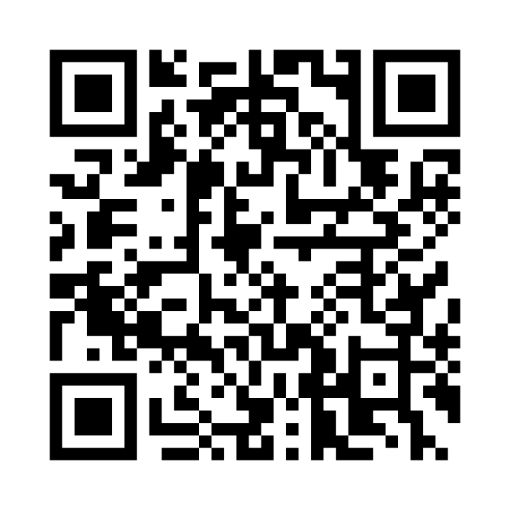
NASA Vendor Database QR Code
Tips for QR code use:
Handouts
Small Business presentations
Email signature
Surveys
Warning
Do not oversaturate QR code use
Website - https://apps.nasa.gov/nvdb/

Slide 9
Where to find opportunities
Source | Website | Comments
SAM | https://sam.gov/ | Federal contract opportunities website
NASA Acquisition Forecast | https://www.hq.nasa.gov/office/procurement/forecast/ | Agency-wide acquisition forecast
NASA Active Contract List | www.nasa.gov/osbp | Current NASA contracts. Also available on the NASA OSBP Mobile App
Small Business Administration Subcontracting Network (SubNet) | https://eweb1.sba.gov/subnet/client/dsp_Landing.cfm | Federal subcontracting opportunities
NASA Vendor Database (NVDB) | https://apps.nasa.gov/nvdb/ | Register to share capabilities and receive NASA Procurement notices. NVDB is a market research tool for Acquisition personnel.
NASA Mentor Protégé | https://osbp.nasa.gov/mpp/index.html | NASA MPP encourages NASA prime contractors to assist eligible Protégés, thereby enhancing the Protégés’ capabilities to perform on NASA contracts and subcontracts, fostering the establishment of long-term business relationships between these entities and NASA prime contractors, and increasing the overall number of these entities that receive NASA contract and subcontract awards
NASA Solicitation and Proposal Integrated Review and Evaluation System (NSPIRES) | https://nspires.nasaprs.com/external/ | Research opportunities in science and technology
NASA Small Business Innovation Research/Small Business Technology Transfer (SBIR/STTR) | https://sbir.gsfc.nasa.gov/ | Opportunities for small, high technology companies and research institutions to participate in Federal Government sponsored R&D efforts in key technology areas
TechPort | https://techport.nasa.gov/ | Showcases NASA’s portfolio of active and completed technology projects.
NASA Technology Transfer 2023/2024 Software Catalog | https://software.nasa.gov/ | NASA's Software Catalog offers hundreds of new software programs you can download for free to use in a wide variety of technical applications.

Slide 10
Where to find Assistance
Source | Website
SBA – Richmond District Office | https://www.sba.gov/district/virginia?utm_medium=email&utm_source=govdelivery
Virginia APEX Accelerators (formally PTAC) | https://virginiaptac.org/?utm_medium=email&utm_source=govdelivery
Service Corps of Retired Executives (SCORE) | https://www.score.org/?utm_medium=email&utm_source=govdelivery
Veteran Business Outreach Center (VBOC) | https://www.odu.edu/iie/vboc?utm_medium=email&utm_source=govdelivery
Virginia Small Business Development Center (SBDC) | https://www.virginiasbdc.org/business-recovery-center/
Women’s Business Center (WBC) - ODU | https://www.odu.edu/iie/wbc?utm_medium=email&utm_source=govdelivery
Women’s Business Center (WBC) of Richmond – The Institute and Virginia Union University (VUU) | https://theinstitutenc.org/WBCRichmond/

Slide 11
Contact Information & Links
Robert Betts
Small Business Specialist
NASA Office of Small Business Programs – IT Procurement Office & Langley Research Center
Tel: (757) 864-6074
Email: larc-SmallBusiness@mail.nasa.gov
Website: www.nasa.gov/osbp
NASA Vendor Database: https://apps.nasa.gov/nvdb/
NASA Partnerships: www.nasa.gov/partnerships
NASA Tech Transfer: http://technology.nasa.gov
NASA SBIR/STTR: www.sbir.nasa.gov
2022 NASA Langley Research Center Annual Report: https://oh.larc.nasa.gov/oh/annual-report/2022/
NASA Spinoff 2023: https://spinoff.nasa.gov/sites/default/files/2023-01/NASA-Spinoff-2023.pdf

