Slide 1
LCSC Small Business Update
Robert Betts
NASA Office of Small Business Programs
Langley Research Center
July 20, 2023

Slide 2
NASA Agency October - June FY23 Prime Goals vs. Actual Percentages Data generated July 7, 2023 from SAM.GOV
CATEGORY | DOLLARS
TOTAL DOLLARS | $14,736,496,892
SMALL BUSINESS | $2,227,933,492
SDB | $1,017,484,825
WOSB | $522,927,393
HUBZone | $133,483,164
SDVOSB | $287,158,133

Slide 3
Langley Research Center (LaRC) October - June FY23 Prime Goals vs. Actual Percentages Data generated July 7, 2023 from SAM.GOV
CATEGORY | DOLLARS
TOTAL DOLLARS | $298,423,678
SMALL BUSINESS | $146,876,426
SDB | $35,146,275
WOSB | $14,101,974
HUBZone | $2,449,876
SDVOSB | $1,171,519

Slide 4
UPCOMING OPPORTUNITIES
Name of Procurement | NAICS Code | Set-Aside | Est. RFP/RFQ Release | Remarks
B777-200ER Viewport Installations | 336411 | Total SB | 7/31/23 | 80LARC23R0018 DRFP Responses due 7/26/23 POC: Octavia Hicks (Octavia.L.Hicks@nasa.gov)
Langley Logistics Support Services (LSS) 2 | 541614 | 8(a) | TBD | POC: Kimberly Wilson (Kimberly.C.Wilson@nasa.gov)
Glenn-Langley Administrative Support Services (GLASS) | 561110 | 8(a) | 6/30/23 | 80LARC23R0014 Responses due 8/1/23 POC: Natasha King (LARC-GLASS@mail.nasa.gov)
Center Maintenance, Operations, and Engineering (CMOE) II | 561210 | No | July 2023 | CMOE_II_RFI_SS DRFP Responses due 7/7/23 POC: Ola Charles (larc-cmoe-ii@mail.nasa.gov)

Slide 5
Upcoming Learning Opportunities
Date | Topic | Presenter | Comments/Registration
July 25 | Let's Get SWaMmed!: Hands-On Certification Application Assistance | Virginia SBSD | https://www.eventbrite.com/e/lets-get-swammed-hands-on-certification-application-assistance-tickets-646188787057?aff=erelexpmlt
August 16 | NASA Mission Equity: Tribal Consultation Plan Update | NASA OSBP | https://www.nasa.gov/osbp/learning-series
September 20 | How to Write Proposals and Impactful Capability Statements | NASA OSBP | https://www.nasa.gov/osbp/learning-series

Slide 6
Upcoming Outreach Opportunities
Date | Topic | Host | Location | Comments/Registration
July 26 | National Small Business Federal Contracting Summit – Summer 2023 | US Women's Chamber of Commerce | Virtual | Virtual: https://womenowned.us/member/SelectPackage?eventId=6142
August 7 | Naval Research Laboratory Virtual Small Business Industry Day 2023 | Naval Research Laboratory | Virtual | https://virginiaptac.ecenterdirect.com/events/3944
August 9 | Light Manufacturing Industry Day | NASA JSC | NASA JSC Houston, TX | https://www.eventbrite.com/e/nasa-jsc-light-manufacturing-industry-day-tickets-663617877937?aff=ebdssbdestsearch
August 22-23 | National HUBZone Conference | HUBZone Contractors National Council | Leesburg, VA | https://hubzonecouncil.org/event-5059938
October 10-11 | National Small Business Federal Contracting Summit – Fall 2023 | US Women's Chamber of Commerce | Hybrid | https://www.uswcc.org/events/national-small-business-federal-contracting-summit-fall-2023-dc-area-hybrid/
October 11 | NASA Small Business Conference and Networking | NASA OSBP | Washington DC area | https://www.nasa.gov/osbp/regional-outreach
October 19 | NASA LaRC Open House – Industry & Academia Day | NASA LaRC | NASA LaRC | TBA
December 5-6 | Tri-State Procurement Technical Assistance Centers (PTAC) Mega Matchmaker | NY/PA/OH PTACs | Virtual | https://www.tri-state-ptac-mega-matchmaker.com

Slide 7
Miscellaneous
Seeking nominations for FY2023 SB Subcontractor of the Year
OSBP launched new and improved NASA Vendor Database
Register at https://apps.nasa.gov/nvdb/
Even previously registered companies will need to re-register at the new site

Slide 8
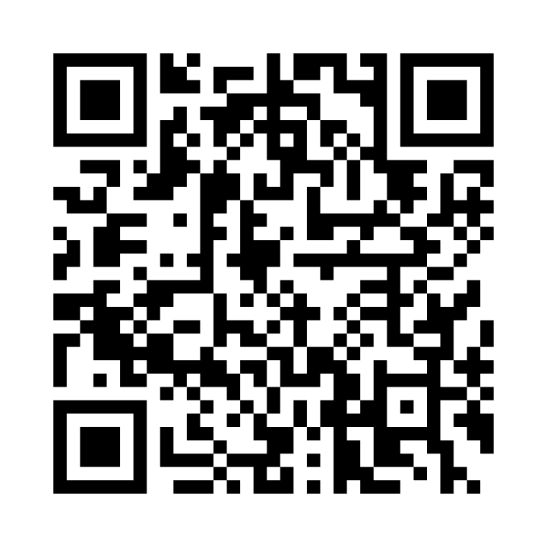
NASA Vendor Database QR Code
Tips for QR code use:
Handouts
Small Business presentations
Email signature
Surveys
Warning
Do not oversaturate QR code use
Website - https://apps.nasa.gov/nvdb/

Slide 9
Where to find opportunities
Source | Website | Comments
SAM | https://sam.gov/ | Federal contract opportunities website
NASA Acquisition Forecast | https://www.hq.nasa.gov/office/procurement/forecast/ | Agency-wide acquisition forecast
NASA Active Contract List | www.nasa.gov/osbp | Current NASA contracts. Also available on the NASA OSBP Mobile App
Small Business Administration Subcontracting Network (SubNet) | https://eweb1.sba.gov/subnet/client/dsp_Landing.cfm | Federal subcontracting opportunities
NASA Vendor Database (NVDB) | https://apps.nasa.gov/nvdb/ | Register to share capabilities and receive NASA Procurement notices. NVDB is a market research tool for Acquisition personnel.
NASA Mentor Protégé | https://osbp.nasa.gov/mpp/index.html | NASA MPP encourages NASA prime contractors to assist eligible Protégés, thereby enhancing the Protégés’ capabilities to perform on NASA contracts and subcontracts, fostering the establishment of long-term business relationships between these entities and NASA prime contractors, and increasing the overall number of these entities that receive NASA contract and subcontract awards
NASA Solicitation and Proposal Integrated Review and Evaluation System (NSPIRES) | https://nspires.nasaprs.com/external/ | Research opportunities in science and technology
NASA Small Business Innovation Research/Small Business Technology Transfer (SBIR/STTR) | https://sbir.gsfc.nasa.gov/ | Opportunities for small, high technology companies and research institutions to participate in Federal Government sponsored R&D efforts in key technology areas
TechPort | https://techport.nasa.gov/ | Showcases NASA’s portfolio of active and completed technology projects.

Slide 10
Where to find Assistance
Source | Website
SBA – Richmond District Office | https://www.sba.gov/district/virginia?utm_medium=email&utm_source=govdelivery
Virginia Procurement Technical Assistance Center (PTAC) | https://virginiaptac.org/?utm_medium=email&utm_source=govdelivery
Service Corps of Retired Executives (SCORE) | https://www.score.org/?utm_medium=email&utm_source=govdelivery
Veteran Business Outreach Center (VBOC) | https://www.odu.edu/iie/vboc?utm_medium=email&utm_source=govdelivery
Virginia Small Business Development Center (SBDC) | https://www.virginiasbdc.org/business-recovery-center/
Women’s Business Center (WBC) - ODU | https://www.odu.edu/iie/wbc?utm_medium=email&utm_source=govdelivery
Women’s Business Center (WBC) of Richmond – The Institute and Virginia Union University (VUU) | https://theinstitutenc.org/WBCRichmond/

Slide 11
Contact Information & Links
Robert Betts
Small Business Specialist
NASA Office of Small Business Programs – IT Procurement Office & Langley Research Center
Tel: (757) 864-6074
Email: larc-SmallBusiness@mail.nasa.gov
Website: www.nasa.gov/osbp
NASA Vendor Database: https://apps.nasa.gov/nvdb/
NASA Partnerships: www.nasa.gov/partnerships
NASA Tech Transfer: http://technology.nasa.gov
NASA SBIR/STTR: www.sbir.nasa.gov
2022 NASA Langley Research Center Annual Report: https://oh.larc.nasa.gov/oh/annual-report/2022/
NASA Spinoff 2023: https://spinoff.nasa.gov/sites/default/files/2023-01/NASA-Spinoff-2023.pdf

