Slide 1
LCSC Small Business Update
Robert Betts
NASA Office of Small Business Programs
Langley Research Center
June 22, 2023

Slide 2
NASA Agency October - May FY23 Prime Goals vs. Actual Percentages Data generated June 6, 2023 from SAM.GOV

Slide 3
Langley Research Center (LaRC) October - May FY23 Prime Goals vs. Actual Percentages Data generated June 6, 2023 from SAM.GOV

Slide 4
UPCOMING OPPORTUNITIES
Name of Procurement | NAICS Code | Set-Aside | Est. RFP/RFQ Release | Remarks
Request for Information on Advancing Racial Equity and Support for Underserved Communities in NASA Procurements and Federal Financial Assistance | N/A | N/A | N/A | https://sam.gov/opp/eed0faaf3dd04afb8a3fccc46d99b5ee/view
Force Measurements Support Services | 334511 | No | 5/22/23 | 80LARC23R0015 Proposals due 6/30/23 POC: Ambreen Sanchez (Larc-fmss3@mail.nasa.gov)
Langley Logistics Support Services (LSS) 2 | 541614 | 8(a) | TBD | RFI issued 1/26/23 (LSS2-Sources-Sought_RFI) Responses due 2/15/23 POC: Kimberly Wilson (Kimberly.c.Wilson@nasa.gov)
Glenn-Langley Administrative Support Services (GLASS) | 561110 | 8(a) | 6/30/23 | DRFP issued 5/25/23 (80LARC23R0014) Responses due 6/8/23 POC: Natasha King (LARC-GLASS@mail.nasa.gov)
Center Maintenance, Operations, and Engineering (CMOE) II | 561210 | TBD | July 2023 | Draft RFP issued 6/7/23 (CMOE_II_RFI_SS) Virtual Preproposal Conference: 6/21/23 Responses due 7/7/23 POC: Ola Charles (larc-cmoe-ii@mail.nasa.gov)

Slide 5
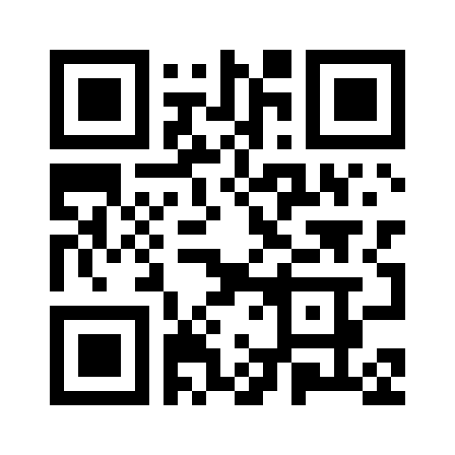
Request for Information on Advancing Racial Equity and Support for Underserved Communities in NASA Procurements and Federal Financial Assistance
NASA has issued a Request for Information (RFI) to receive input from the public on the barriers and challenges that prevent members of underserved communities (as defined in Executive Order 13985, Advancing Racial Equity and Support for Underserved Communities Through the Federal Government, and Executive Order 14091, Further Advancing Racial Equity and Support for Underserved Communities Through the Federal Government) from participating in NASA's procurements, grants, and cooperative agreements.
Document Citation: FR 21725
Publication date: April 11, 2023
60 days comment period extended to July 11, 2023

Slide 6
Upcoming Learning Opportunities
Date | Topic | Presenter | Comments/Registration
June 26 | Federal Solicitation and Proposal Management, Developing a Proposal Outline | Virginia PTAC | https://virginiaptac.ecenterdirect.com/events/3632
June 29 | Limitations on Subcontracting & The SBA's Government-wide Mentor Protégé Program | Virginia PTAC | https://virginiaptac.ecenterdirect.com/events/3683
June 29 | Small, Women or Minority (SWaM) Certification Information Session (Virginia Beach) | Virginia SBSD | https://www.eventbrite.com/e/swam-certification-information-session-eastern-virginia-region-tickets-631079916017?aff=erelexpmlt
July 11 | ISR/SSR Training | NASA OSBP & KSC Prime Council | Microsoft Teams Meeting (Click here to join the meeting)
July 19 | NASA SEWP Update | NASA OSBP | https://www.nasa.gov/osbp/learning-series
July 25 | Let's Get SWaMmed!: Hands-On Certification Application Assistance | Virginia SBSD | https://www.eventbrite.com/e/lets-get-swammed-hands-on-certification-application-assistance-tickets-646188787057?aff=erelexpmlt
August 16 | NASA Mission Equity: Tribal Consultation Plan Update | NASA OSBP | https://www.nasa.gov/osbp/learning-series
September 20 | How to Write Proposals and Impactful Capability Statements | NASA OSBP | https://www.nasa.gov/osbp/learning-series

Slide 7
Upcoming Outreach Opportunities
Date | Topic | Host | Location | Comments/Registration
July 19 | National Small Business Federal Contracting Summit (DC Area) Hybrid | US Women's Chamber of Commerce | Hybrid | Live: https://womenowned.us/member/SelectPackage?eventId=6141 Virtual: https://womenowned.us/member/SelectPackage?eventId=6142
July 20 | Small Disadvantaged Businesses….Step Up and Do Business with NASA! | NASA OSBP | Virtual | https://www.eventbrite.com/e/small-disadvantaged-businesses-step-up-and-do-business-with-nasa-registration-647397361937?aff=oddtdtcreator
July 21 | 2023 Small Business Resource Day | ODU Veterans Business Outreach Center | Norfolk, VA | https://www.eventbrite.com/e/2023-small-business-resource-day-tickets-522618133907?aff=erelexpmlt
October 11 | NASA Small Business Conference and Networking | NASA OSBP | Washington DC area | https://www.nasa.gov/osbp/regional-outreach

Slide 8
Miscellaneous
Seeking nominations for FY2023 SB Subcontractor of the Year
OSBP launched new and improved NASA Vendor Database
Register at https://apps.nasa.gov/nvdb/
Even previously registered companies will need to re-register at the new site

Slide 9
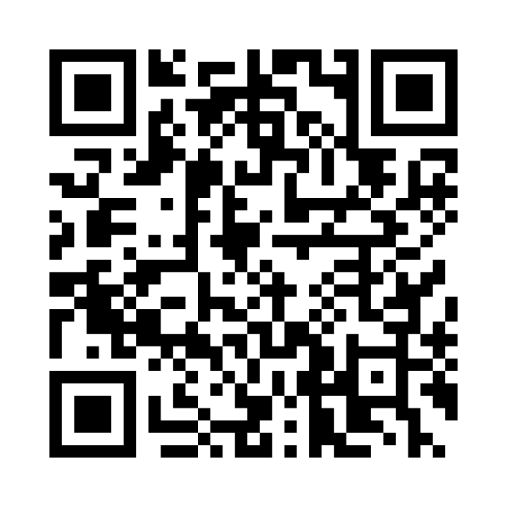
NASA Vendor Database QR Code
Tips for QR code use:
Handouts
Small Business presentations
Email signature
Surveys
Warning
Do not oversaturate QR code use
Website - https://apps.nasa.gov/nvdb/

Slide 10
Where to find opportunities
Source | Website | Comments
SAM | https://sam.gov/ | Federal contract opportunities website
NASA Acquisition Forecast | https://www.hq.nasa.gov/office/procurement/forecast/ | Agency-wide acquisition forecast
NASA Active Contract List | www.nasa.gov/osbp | Current NASA contracts. Also available on the NASA OSBP Mobile App
Small Business Administration Subcontracting Network (SubNet) | https://eweb1.sba.gov/subnet/client/dsp_Landing.cfm | Federal subcontracting opportunities
NASA Vendor Database (NVDB) | https://apps.nasa.gov/nvdb/ | Register to share capabilities and receive NASA Procurement notices. NVDB is a market research tool for Acquisition personnel.
NASA Mentor Protégé | https://osbp.nasa.gov/mpp/index.html | NASA MPP encourages NASA prime contractors to assist eligible Protégés, thereby enhancing the Protégés’ capabilities to perform on NASA contracts and subcontracts, fostering the establishment of long-term business relationships between these entities and NASA prime contractors, and increasing the overall number of these entities that receive NASA contract and subcontract awards
NASA Solicitation and Proposal Integrated Review and Evaluation System (NSPIRES) | https://nspires.nasaprs.com/external/ | Research opportunities in science and technology
NASA Small Business Innovation Research/Small Business Technology Transfer (SBIR/STTR) | https://sbir.gsfc.nasa.gov/ | Opportunities for small, high technology companies and research institutions to participate in Federal Government sponsored R&D efforts in key technology areas
TechPort | https://techport.nasa.gov/ | Showcases NASA’s portfolio of active and completed technology projects.

Slide 11
Where to find Assistance
Source | Website
SBA – Richmond District Office | https://www.sba.gov/district/virginia?utm_medium=email&utm_source=govdelivery
Virginia Procurement Technical Assistance Center (PTAC) | https://virginiaptac.org/?utm_medium=email&utm_source=govdelivery
Service Corps of Retired Executives (SCORE) | https://www.score.org/?utm_medium=email&utm_source=govdelivery
Veteran Business Outreach Center (VBOC) | https://www.odu.edu/iie/vboc?utm_medium=email&utm_source=govdelivery
Virginia Small Business Development Center (SBDC) | https://www.virginiasbdc.org/business-recovery-center/
Women’s Business Center (WBC) - ODU | https://www.odu.edu/iie/wbc?utm_medium=email&utm_source=govdelivery
Women’s Business Center (WBC) of Richmond – The Institute and Virginia Union University (VUU) | https://theinstitutenc.org/WBCRichmond/

Slide 12
Contact Information & Links
Robert Betts
Small Business Specialist
NASA Office of Small Business Programs – IT Procurement Office & Langley Research Center
Tel: (757) 864-6074
Email: larc-SmallBusiness@mail.nasa.gov
Website: www.nasa.gov/osbp
NASA Vendor Database: https://apps.nasa.gov/nvdb/
NASA Partnerships: www.nasa.gov/partnerships
NASA Tech Transfer: http://technology.nasa.gov
NASA SBIR/STTR: www.sbir.nasa.gov
2022 NASA Langley Research Center Annual Report: https://oh.larc.nasa.gov/oh/annual-report/2022/
NASA Spinoff 2023: https://spinoff.nasa.gov/sites/default/files/2023-01/NASA-Spinoff-2023.pdf

