Slide 1
OASIS+
GSA’s future multi-agency contract program for services
NASA Langley Contractors’ Steering Council Meeting
May 18, 2023
Notes:
Karla/Brian

Slide 2
OASIS+ Contract Program
Notes:
Separate socio-economic set-asides
8(a), HUBZone, SDVOSB, WOSB and Total Small Business
8(a) offer and acceptance process compliance at the master contract level
Unrestricted Solicitation
Includes a higher qualifying threshold, additional qualifying criteria such as past performance meeting small business subcontracting goals
Ability to expand socio-economic representation through on-ramping strategy

Slide 3
OASIS+ Unique Features (Draft RFP)
Streamlined IDIQ
Ordering Environment
thru 6 contract programs
Flexible Domain-based structure
Industrial base of highly qualified contractors
Global access to commercial & non-commercial services
No evaluation of price at the contract level
(use of 876 Authority)
No contract ceiling & no cap on number of awards
10-year consecutive coterminous ordering period
Open on-ramping after initial awards
Technology
based ordering
& market research tools
Notes:
Section 876, Increasing Competition At The Task Order, of the 2019 National Defense Authorization Act (NDAA)

Slide 6
OASIS+ Milestones
Market Research
Issue Draft
RFP 1 (Q1)
Issue Draft
RFP 2 (Q2)
Awards Begin to be Announced
OASIS UR Ordering Period Ends (Q4)
FY21
FY23
FY25
FY22
FY24
Acquisition Planning
Issue Final RFP (Q3)
Final Awards Made & NTPs Issued
OASIS SB & 8(a) Ordering Period Ends (Q1)
Draft RFP Phase

Slide 7
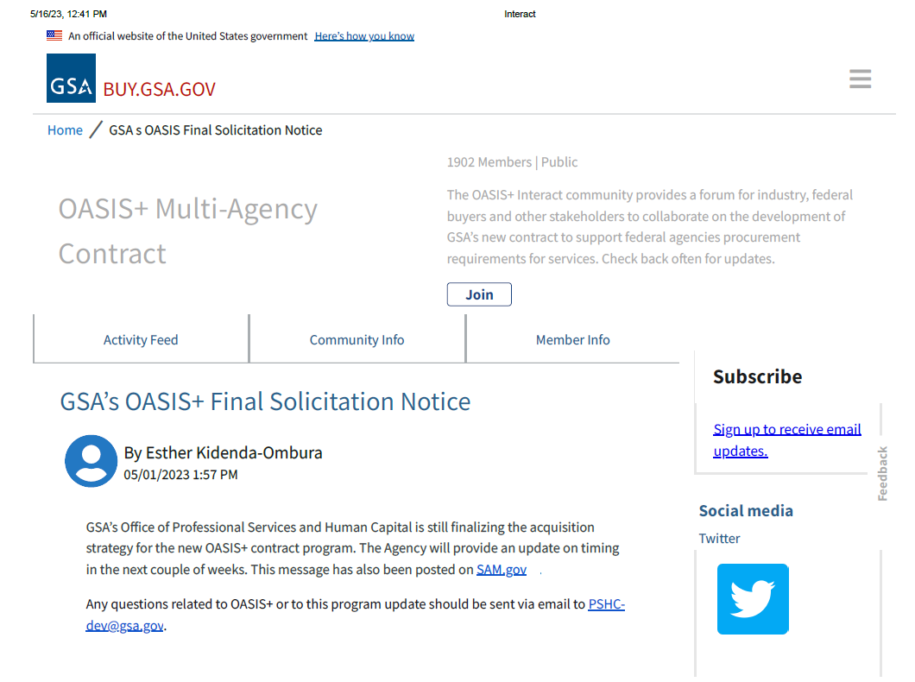

Slide 8
OASIS+ Draft RFP Feedback
Over 2,200 questions and 680 survey responses received in response to Draft RFP; currently under review
Top areas for consideration of feedback/clarification:
RFP requirements and language revisions being made to address feedback and clarify complex areas
Responses posted via SAM.gov, Interact, and Symphony
10-Year Consecutive PoP
C-SCRM
Master Contract CPARS
Sustainability
Teaming
QPs: Relevance & Scale
Past Performance
Contractor Business Systems

Slide 9
OASIS+
Upcoming Industry Engagement Opportunities
2nd Draft RFP
Informational; incorporating revisions resulting from feedback and questions
No formal question/comment period
Industry Day/Pre-Solicitation Conference
Immediately following 2nd Draft RFP release
Pre-Proposal Conference and
Offer Submission System Training for OASIS+ Offerors
In conjunction with Final RFP release

Slide 10
OASIS+ Scope & Fair Opportunity Structure
Proposed Phase 1 Domains
Proposed Phase 2 Domains
Technical and Engineering
Financial Services
Research and Development
Business Administration
Management and Advisory
Human Capital
Environmental
Marketing & PR
Intelligence Services
Social Services
Enterprise Solutions
(unrestricted contract only)
Key
Facilities Services
Expanded Scope
HCaTS
Logistics
OASIS
BMO
Notes:
General Domains aligned to subcategories. Industry qualifies for Domain (NAICS are automatically assigned). Contractor can be Small and Other than small within a Domain. Set-aside eligibility by order NAICS. Similar to MAS ordering process. Socioeconomic targets tailored to industry capabilities in each Domain.

Slide 11
OASIS+ Task Order Fair Opportunity
Delegation of Procurement Authority (DPA) required
Pricing and Market Research Tools will enhance the Ordering Agency Experience
Contractor Capabilities Information will be readily available for market research
Pricing Tool will support IGE/IGCE development
Notes:
GSA intends to use authority to not consider price as an evaluation factor at the IDIQ contract level. Industry preferred method - increases competition and less admin burden. Drives prices lower: Ceiling rates can be detrimental to negotiations. Competitors don’t have visibility into what others charge. GSA will capture enhanced Prices Paid Data. Labor Categories/Rates that were used on awarded contracts. Additional data points to help understand the nuances of the rate (experience, location, personnel certifications, etc). Visibility into common labor categories by Domain.

Slide 12
OASIS+ Offer Submission System
Symphony is the web-based tool for proposal management, preparation, and evaluation
Allows for submission of multiple OASIS+ offers with the same, or as needed, different proposal information
The tool helps to ensure your firm is proposing to the desired OASIS+ programs
Access to the tool is available now for registration

Slide 13
Links
GSA Professional Services Twitter Handle:@GSAProfServices
GSA Professional Services LinkedIn Page: PSHC LinkedIn
GSA Professional Services Interact Page: GSA PS Interact
OASIS+ Multi Agency Contract Website: OASIS+
Questions regarding OASIS+: pshc-dev@gsa.gov

