Slide 1
AIAA Hampton Roads Section
Corporate Sponsorship Program

Slide 2
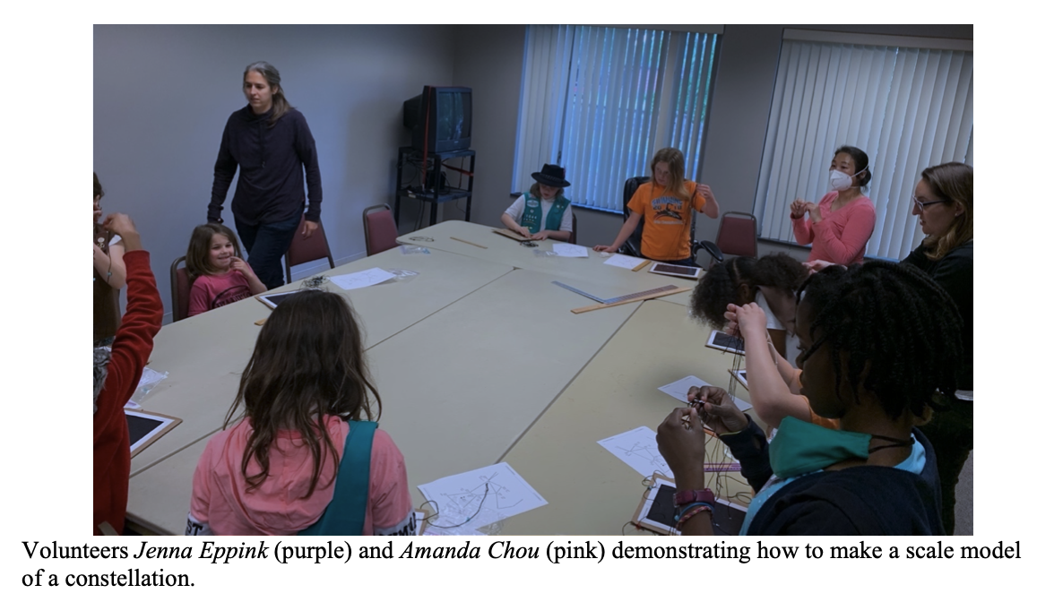
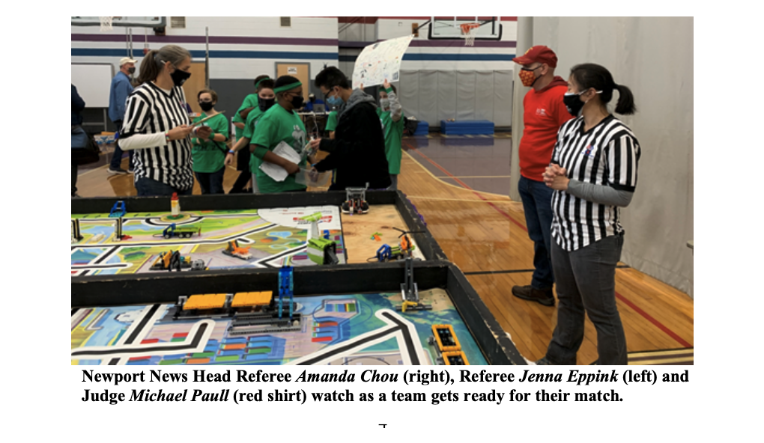
Supports
Futures in Aerospace Scholarship Program
Started in 1985
83 awards totaling $149,000
This year:
Levi Walker of Maryfield Academy, Hampton, Virginia
Karpagam Karthikeyan of Deep Run High School, Glen Allen, Virginia
K-12 and STEM Outreach
Girl Scout Space Science Badge
Lego League Tournament

Slide 3
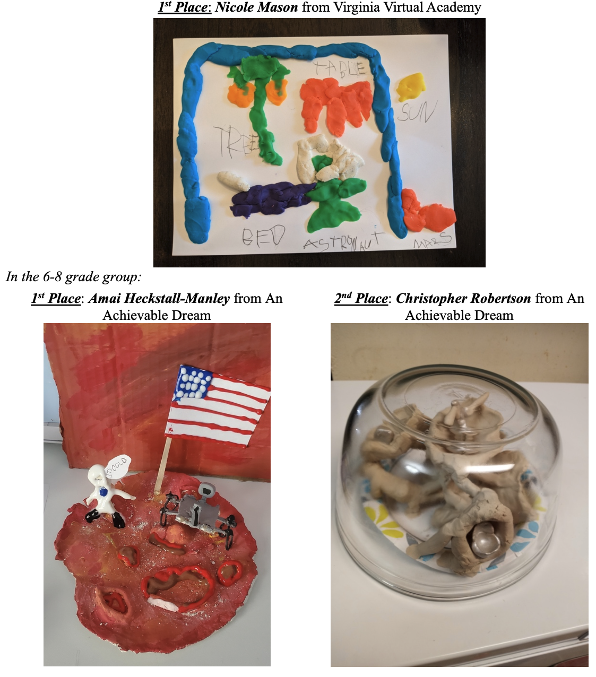
Supports
AIAA HRS Art Contest
Middle School Essay Contest
STEM4Girls
Science Fair
Young Professional Events
Pig Roast
Golf Tournament
Special seminars
Professional recognition and awards

Slide 4
Benefits
Support Designation | Level | Benefits
Bronze | $250 - $499 | An acknowledgement in all issues of Aerospace News, the AIAA HR Newsletter A listing of corporate sponsors on our web site, with a link established to your we site Two free tickets to our Annual Awards Banquet at which Corporate Sponsors ar recognized
Silver | $500 - $749 | Bronze level benefits and a quarter page of advertising space in all issues of Aerospace News for one year.
Gold | $750 - $999 | Silver benefits and a half-page advertising space in all issues of Aerospace New for one year Two free tickets for our Fall Oyster Roast Free listing of employment opportunities with your firm in all issues of Aerospace News for one year* Complementary individual entries in our annual Futures in Aerospace golf tournament to be held this Fall
Platinum | $1000 or more | Gold benefits and a full-page advertising space in all of the issues of Aerospace News for one year Four free tickets for the Fall Oyster Roast, Complimentary team entry (four people) for our annual Futures in Aerospace golf tournament to be held this Fall

Slide 5
But the main benefit is:
Supporting the local community, students, and co-workers!
Thank you for your consideration!
Contact:
Richard White
rwhite@vigyan.com
757 291-3410

