Slide 1
Controlled Unclassified Information (CUI) Overview
Mike Guerin

Slide 2
Control Unclassified Information (CUI)
What is the CUI Program?
  The CUI Program is an information security reform that standardizes the way the government handles information that requires protection.
What is CUI?
  Controlled Unclassified Information (CUI) is information that requires safeguarding as per applicable laws, regulations, or Government-wide policies.

Slide 3
Where Did It Come From?
Executive Order 13556, “Controlled Unclassified Information,” November 4, 2010.
32 Code of Federal Regulations, part 2002, September 14, 2016.
NPD 2810.1, NASA Information Security Policy
NPR 2810.7, Controlled Unclassified Information

Slide 4
Legacy Information
Legacy information that is marked as SBU, prior to the CUI program implementation (prior to October 1, 2021).
  NASA waiver states that you do not have to remark SBU information as CUI, unless you reuse or transmit it outside of NASA.
  Instead of updating legacy content markings to CUI, NASA permits the use of a CUI coversheet for legacy material. The CUI Coversheet must include all necessary CUI categories and Dissemination controls applicable to the document

Slide 5
Why Protect CUI?
The loss or improper safeguarding of CUI could be expected to have a serious adverse effect on organizational operations, organizational assets, or individuals.
  Significant degradation in mission capability to an extent and duration that the organization can perform its primary functions, but the effectiveness of the functions is significantly reduced;
  Significant damage to organization assets;
  Significant financial loss; or
  Significant harm to individuals that does not involve loss of life or serious life-threatening injuries
The loss or improper safeguarding of CUI can have impact on national security

Slide 6
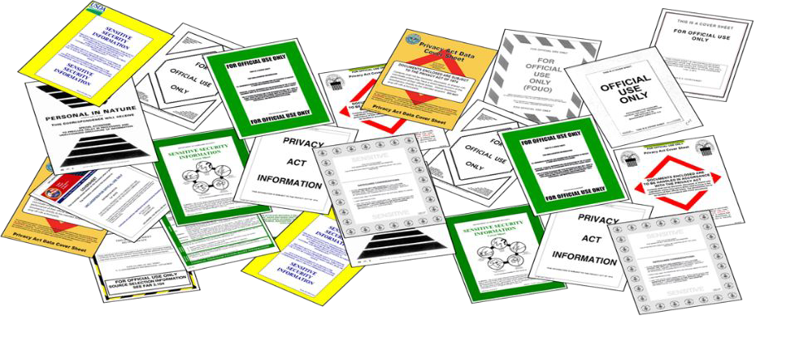
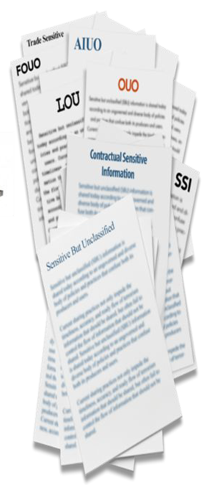
Why Mark CUI?
We mark to inform users or recipients that information is CUI and to alert them of any dissemination or safeguarding requirements.

Slide 7
Responsibilities
It is the responsibility of all NASA personnel to ensure that CUI is managed and protected in accordance with NASA policies
  Civil Servants
  Contractors
  Guest Researchers
  Interns

Slide 8
CUI Banner Marking Basics
CUI Control Marking (required)
Limited Dissemination Control Marking (if required)
CUI//Category//Dissemination
“CUI” is all that is required for CUI Basic
CUI Banner Markings must appear on the top portion of the pages (optional best practice –add to bottom of pages)
The Banner Marking should be easily distinguishable and readily apparent (bold, capitalized and centered when feasible)
CUI Category Marking (if required)

Slide 9
CUI Basic and CUI Specified
CUI Basic: Laws, Regulations, or Government-wide policies DO NOT require specific protections.
CUI Specified: Laws, Regulations, or Government-wide policies require specific protections. For example:
  Unique markings
  Enhanced physical safeguards
  Limits on who can access the information
CUI Specified examples:
  Export Control: CUI//SP-EXPT
  Privacy Information (PII): CUI//SP-PRVCY
  Proprietary Business Information: CUI//SP-PROPIN

Slide 10
Limited Dissemination Control Markings
Common Dissemination Controls
  No foreign dissemination – NOFORN
  Federal Employees Only – FED ONLY
  Federal Employees and Contractors only – FEDCON

Slide 11
Banner Marking Examples
Document contains Proprietary Business Information and should not be disseminated to any foreign nationals:
CUI//SP-PROPIN//NOFORN
Document is Export Controlled has no limited dissemination controls:
CUI//SP-EXPT
Document is CUI basic, no specified category (for example System Vulnerability Information):
CUI

Slide 12
Other Examples
CUI//SP-PERS or CUI//SP-PRVCY
  PERS: Internal Personnel records
  PRVCY: General Privacy (Medical Data, PII)
CUI//SP-FNC – General Financial Information
  Related to the duties, transactions, or otherwise falling under the purview of financial institutions or United States Government fiscal functions. Uses may include, but are not limited to, customer information held by a financial institution.
CUI//SP-PROCURE – General Procurement and Acquisition
  Material and information relating to, or associated with, the acquisition and procurement of goods and services, including but not limited to, cost or pricing data, contract information, indirect costs and direct labor rates.

Slide 13
Marking CUI – Export Controlled
CUI//SP-EXPT
Unclassified information concerning certain items, commodities, technology, software, or other information whose export could reasonably be expected to adversely affect the United States national security and nonproliferation objectives. To include dual use items; items identified in export administration regulations (EAR), international traffic in arms regulations and the munitions list (ITAR); license applications; and sensitive nuclear technology information.
https://nasa.sharepoint.com/sites/exportcontrol

Slide 14
Coversheets
Coversheets are optional
Can be printed in purple or black and white
Should also include categories/dissemination controls
The SF901 is the ONLY approved coversheet
  https://www.gsa.gov/cdnstatic/SF901-18a.pdf?forceDownload=1
Document(s) must still be marked even if a coversheet is used!

Slide 15
Storing CUI
Office 365 services (SharePoint, Teams, Planner, Forms, OneDrive) are approved for the use of storing CUI. The CUI does not need to be encrypted in Office 365
Box is approved for storing and sharing CUI.
Physical Copies of CUI must be stored in a lockable drawer/cabinet when away from desk.

Slide 16
Sharing CUI
Emails must be encrypted when sending CUI. Only email CUI to users that have a lawful government purpose. The email must include the CUI banner marking at the top of the body of the email.
  Additionally, adding a transmittal notice permits the email to be UUI when the CUI attachment is detached: “​​​​​​​This email is Uncontrolled Unclassified Information (UUI) when the attachment is removed.”
If in a Teams meeting, please be aware of all participants before sharing any CUI.
Box can be used for sharing CUI with external parties.
  More information on this process can be found here: https://nasa.sharepoint.com/sites/EUSO/SitePages/Large-File-Transfer-(LFT).aspx

Slide 17
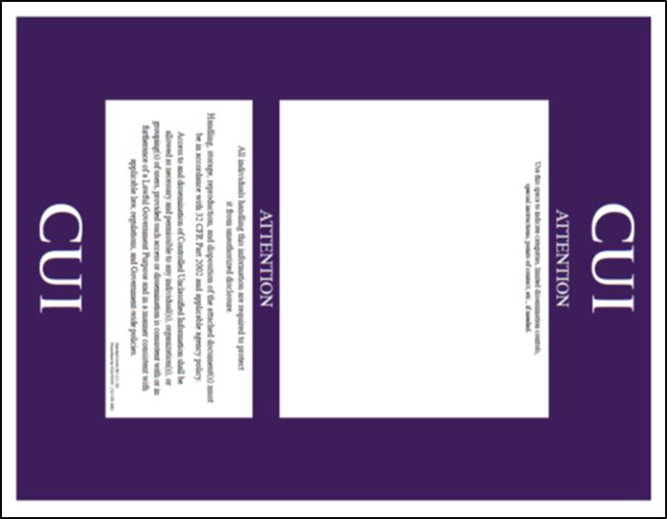
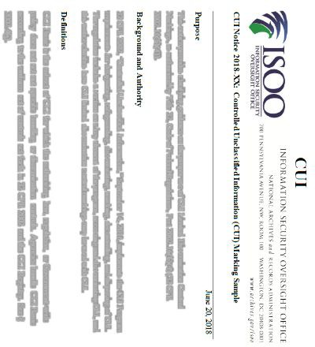
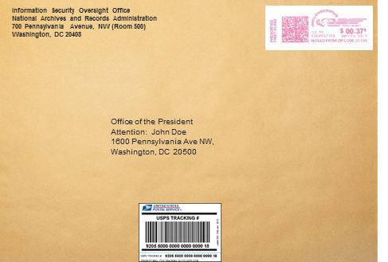

Shipping CUI
CUI may be shipped
– Best practice is to track the package
DO NOT
CUI
Place Markings on Packages/Envelopes
CUI

Slide 18
Resources
National Archives – Federal Governments’ site for CUI Information
  https://www.archives.gov/cui
Nation Archives – CUI Registry
  https://www.archives.gov/cui/registry/category-list
NASA OCIO SharePoint – NASA Guidance for CUI
  https://nasa.sharepoint.com/sites/privacy
NASA Controlled Unclassified Information Handbook (ITS-HBK-CUI_v1.0.0)
  https://cset.nasa.gov/wp-content/uploads/2021/05/ITS-HBK-CUI_v1.0.0.pdf

Slide 19
Contact Information
CUI Email
  NASA-CUI@mail.nasa.gov
Mike Guerin – Center Privacy Manager (CPM) and CUI Liaison for LaRC
  Michael.D.Guerin@nasa.gov

