Slide 1
Partnerships Brief Contractor Steering Council
OSACB – Carrie Rhoades
June 2021

Slide 2
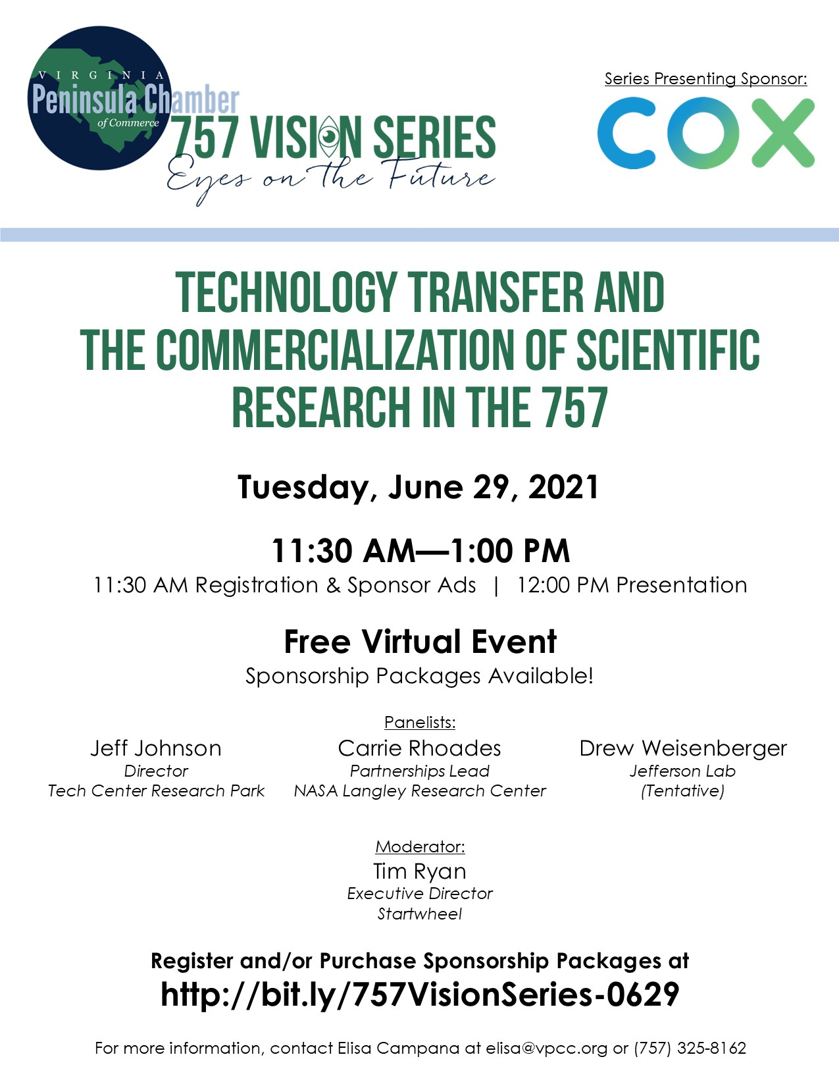
757 Vision Series:
Technology Transfer and the Commercialization of Scientific Research in the 757
June 29, 2021 at 11:30 AM
http://bit.ly/757VisionSeries-0629

Slide 3
June
Conference | Acronym Title when shown | Start Date | End Date | Location | Website
Cognitive Communications for Aerospace Applications (CCAA) Workshop |  | 6/21/2021 | 6/23/2021 | Virtual | https://www.aiaa.org/events-learning/event/2021/06/21/default-calendar/3rd-cognitive-communications-for-aerospace-applications-(ccaa)-workshop
RAPID.TECH + FABCON 3.D |  | 6/22/2021 | 6/23/2021 | Virtual | https://www.rapidtech-3d.com/

Slide 4
July
Conference | Acronym Title when shown | Start Date | End Date | Location | Website
Satellite Conference | July 26-29 | SATELLITE | 7/26/2020 | 7/29/2020 |  | https://www.satshow.com/
Satellite Exhibition | July 27-29 | SATELLITE | 7/27/2020 | 7/29/2020 |  | https://www.satshow.com/
RHESSI Workshop |  | 7/7/2021 | 7/9/2021 | Pisa, Italy | https://agenda.infn.it/event/20574/
IEEE Geoscience and Remote Sensing Society (IGARSS) | IGARSS | 7/11/2021 | 7/16/2021 | Brussels, Belgium | https://igarss2021.org/
International Conference on Environmental Systems (ICES) | ICES | 7/11/2021 | 7/15/2021 | Lisbon, Portugal | https://www.ices.space/ices-info/
Defense Manufacturing Conference (DMC) | DMC | 7/12/2021 | 7/16/2021 | Orlando, Fl | http://www.dmcmeeting.com/
Annual INCOSE International Symposium | INCOSE | 7/17/2021 | 7/22/2021 | Honolulu, HI | https://www.incose.org/symp2021
IEEE Nuclear and Space Radiation Effects Conference (NSREC) | NSREC | 7/19/2021 | 7/21/2021 | Ottawa, Canada | http://www.nsrec.com/nsrec_2021.html
Satellite 2021 |  | 7/26/2021 | 7/29/2021 |  | https://www.satshow.com/
EAA Airventure Oshkosh |  | 7/26/2021 - 8/1/2021 |  | Oshkosh, WI | https://www.eaa.org/airventure

Slide 5
August
Conference | Acronym Title when shown | Start Date | End Date | Location | Website
Asia Oceana Geosciences Society |  | 8/1/2021 | 8/6/2021 | Virtual & Singapore | http://www.asiaoceania.org/aogs2019/public.asp?page=home.htm
International Conference on Automated Planning and Scheduling | ICAPS | 8/2/2021 | 8/13/2021 | Vitual/China | https://xplan-lab.org/icaps2021/
AIAA Aviation Forum |  | 8/2/2021 | 8/6/2021 | Virtual | https://aviation.aiaa.org/
AIAA/CEAS Aeroacoustics Conference (Aeroacoustics ) |  | 8/2/2021 | 8/6/2021 |  | https://www.aiaa.org/Aeroacoustics-2019/
Solar Heliospheric & Interplanetary Environment (SHINE) Conference | SHINE | 8/2/2021 | 8/6/2021 | Honolulu, HI | https://shinecon.org/CurrentMeeting.php
AIAA Aviation and Aeronautics Forum and Exposition (2021 AIAA AVIATION Forum) | AVIATION | 8/2/2021 | 8/6/2021 | Virtual | https://www.aiaa.org/events-learning/event/2021/08/02/default-calendar/2021-aiaa-aviation-and-aeronautics-forum-and-exposition
Small Satellite Conference | SmallSat | 8/7/2021 | 8/12/2021 | Virtual | https://smallsat.org/
AIAA Propulsion and Energy Forum and Exposition (AIAA Propulsion and Energy ) |  | 8/9/2021 | 8/11/2021 | Denver, CO | https://www.aiaa.org/propulsionenergy
AIAA Propulsion and Energy Forum and Exposition (AIAA Propulsion and Energy Forum) |  | 8/9/2021 | 8/11/2021 | Virtual | https://www.aiaa.org/events-learning/event/2021/08/09/default-calendar/2021-aiaa-propulsion-and-energy-forum-and-exposition-(aiaa-propulsion-and-energy-forum)
AIAA/IEEE Electric Aircraft Technologies Symposium (EATS) | EATS | 8/11/2021 | 8/13/2021 | Virtual | https://www.aiaa.org/events-learning/event/2021/08/11/default-calendar/EATS
Annual Meeting of The Meteoritical Society |  | 8/14/2021 | 8/21/2021 | Chicago, IL | https://meteoritical.org/society/annual-meetings
Satellite Digital Encore | August 16-20 | SATELLITE | 8/16/2021 | 8/20/2021 |  | https://www.satshow.com/
AUVSI Xponential |  | 8/16/2021 | 8/19/2021 | Atlanta, GA | https://www.xponential.org/xponential2021/public/enter.aspx

Slide 6
August Continued
Conference | Acronym Title when shown | Start Date | End Date | Location | Website
Air Force Space Pitch Day |  | 8/18/2021 | 8/19/2021 |  | Spaceforcepitchday.com
Space Symposium by the Space Foundation |  | 8/23/2021 | 8/26/2021 | Hybrid - Virtual/Colorodo Springs, CO | https://www.spacesymposium.org/
ISS Research & Development Conference - ISS R&D - Innovation Beyond Boundaries |  | 8/27/2021 | 10/22/2021 |  | https://www.issconference.org/
Military Sensing Symposium (MSS) Parallel Conference (Passive, BSD, and M&D) | MSS, BSD, M&D | 8/30/2021 | 9/2/2021 | Orlando, FL | https://www.mssconferences.org/public/meetings/conferenceDetail.aspx?enc=GfDU%2bZmq%2bv4HMMQH%2ff7CZA%3d%3d
European Conference on Radar in Meteorology and Hydrology (ERAD) | ERAD | 8/29/2022 | 9/2/2022 | Switzerland | https://www.erad2020.ch/

Slide 7
Sept
Conference | Acronym Title when shown | Start Date | End Date | Location | Website
OSAM Technology Transfer Workshop |  | 9/22/2020 | 9/23/2020 | NASA MSFC | https://nexis.gsfc.nasa.gov/osam/ttw/index.html#:~:text=NASA%20hosts%20an%20annual%20technology,OSAM%20technologies%20to%20U.S.%20industry.&text=Workshop%20attendees%20will%20enjoy%20access,a%20tour%20of%20NASA%20facilities.
International Conference on Thermoelectrics - ICT |  | 9/5/2021 | 9/8/2021 | Krakow, Poland | https://ict2021.agh.edu.pl/
Congress of the International Council of the Aeronautical Sciences (ICAS) (Postponed) | ICAS | 9/6/2021 | 9/10/2021 | Shanghai, China | https://www.aiaa.org/events-learning/event/2021/09/06/default-calendar/32nd-congress-of-the-international-council-of-the-aeronautical-sciences-(icas)
RAPID + TCT |  | 9/13/2021 | 9/15/2021 | Chicago, IL | https://rapid3devent.com/
SPIE Remote Sensing |  | 9/13/2021 | 9/16/2021 | Madrid, Spain | https://spie.org/conferences-and-exhibitions/remote-sensing
Fabtech |  | 9/13/2021 | 9/16/2021 | Chicago, IL | https://www.fabtechexpo.com/
International Academy of Astronautics (IAA) Conference on Space Situational Awareness |  | 9/13/2021 | 9/16/2021 | Madrid, Spain | https://www.aiaa.org/events-learning/event/2021/09/13/default-calendar/3rd-international-academy-of-astronautics-(iaa)-conference-on-space-situational-awareness
AIAA Defense |  | 9/14/2021 | 9/16/2021 | Laurel, MD | https://defense.aiaa.org/
Air Force Association National Air, Space, and Cyber Conference |  | 9/20/2021 | 9/22/2021 | National Harbor, MD | www.afa.org
AIAA Defense and Security Forum (AIAA DEFENSE Forum) |  | 9/20/2021 | 9/22/2021 | Laurel, MD | https://www.aiaa.org/events-learning/event/2021/09/20/default-calendar/2021-aiaa-defense-and-security-forum-(aiaa-defense-forum)
EuroPlanet Science Congress |  | 9/21/2021 | 10/9/2021 | Virtual | https://www.epsc2020.eu/
FOSS4G North America |  | 9/27/2021 | 10/2/2021 | Virtual | https://2019.foss4g-na.org/

