Slide 1
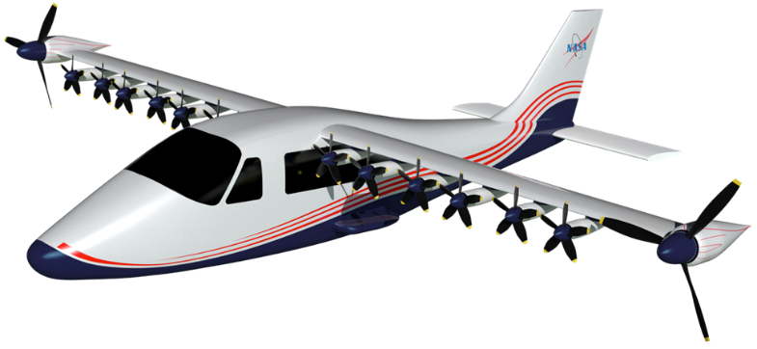
NASA’s X-57 Maxwell All-Electric Aircraft
Keith Harris
X-57 Vehicle IPT Lead
December 11, 2019
Langley Contractor Steering Council

Slide 2
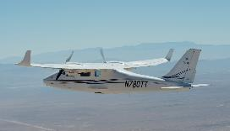
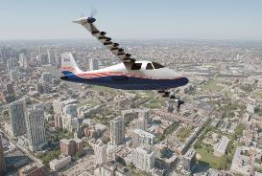
Meet the X-57 Maxwell
The X-57 Maxwell is NASA first all electric experimental aircraft and the agency’s first crewed X- plane in two decades
  Highly Modified Tecnam P2006T
Need
  Advance the Nation's ability to design, test, and determine airworthiness of distributed electric and aero-propulsive coupling technologies, which are a critical enabler of emerging, advanced air mobility markets.
Goals
  Goal-1: Share NASA X-57 design & airworthiness process with regulators and standards organizations to further development of distributed electric propulsion (DEP) airworthiness certification approaches and procedures.
  Goal-2: Establish a reference platform for integrated approaches of distributed electric propulsion technologies, including best practices and lessons learned, to advance the Nation's science and industrial base
Tecnam P2006T
X-57 Maxwell

Slide 3
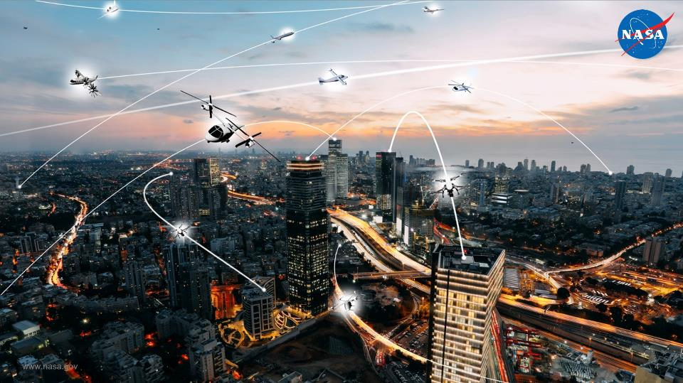
Large Transport
Future
Air Mobility
Short Haul
Urban Air Mobility

Slide 4
FDC Organization
Integrated Aviation Systems Program
Program Director – Ed Waggoner
FDC Project Office
Project Manager – Brent Cobleigh
Deputy PM for Flight Demos – Mike Guminsky
Deputy PM for Flight Capabilities – Tom Horn
AFRC ARD
ARC ARD
GRC ARD
LaRC ARD
Project Support
Project Resource – Mandy Randle
Assistant PM– Angel Guilloty
Risk Manager – Christa Caudillo
Administrative Support – Jasmine Tabla
Center Resource Analysts
Subprojects
Capabilities
X-57 Maxwell
Crossflow Attenuated Natural Laminar Flow (CATNLF)
Schlieren, Airborne Measurements, and Range Operations for Quest (SCHAMROQ)
Transport Gear Noise

Slide 5
X-57 Organizational Structure
Project Manager & COR - Tom Rigney (AFRC)
Deputy PM - Vince Schultz (LaRC)
Principal Investigator – Sean Clarke (AFRC)
Project Management Support – Dave Warner (AFRC)
Acquisition Office – Jenny Staggs (AFRC)
Resource Analyst - Mandy Randle (AFRC)
Project Coordinator - Christina Zinger (AFRC)
Schedule Analyst – Tara Requist (AFRC)
Administrative Assistant – Jasmine Tabla (AFRC)
Project Chief Engineer - Matt Redifer (AFRC)
Deputy CE - Ethan Baumann (AFRC)
Deputy Mod III/IV CE - Claudia Herrera (AFRC)
Operations Engineer - Mike Quinton (AFRC)
Deputy OE - Kirsten Boogaard (AFRC)
Lead Pilot
Tim Williams (AFRC)
Project Support
Vehicle IPT
Keith Harris (LaRC)
V&V Lead
Yohan Lin (AFRC)
Crew Chief
Cory Rung (AFRC)
Configuration Control
Linda Soden (AFRC)
Flight Test Range
Brad Butler (AFRC)
Systems Engineering
Ted Holtz (LaRC)
Complex Systems Lead
Phil Hamory (AFRC)
Lead Avionics Tech
Nick Whitman (AFRC)
Quality Assurance
Joel Hiddema (AFRC)
Systems Safety
Phil Burkhardt (AFRC)
Flight Controls IPT
Dave Cox (LaRC)
Software Manager
Keith Schweikhard (AFRC)
Deputy SW Manager
Lucas Moxey (AFRC)
Public Affairs
Matt Kamlet (AFRC)
Performance & Sizing IPT
Nick Borer (LaRC)
Power & Command IPT
Sean Clarke (AFRC)
Wing IPT
Jeff Viken (LaRC)
NASA Glenn: Battery Testing, Thermal Analysis, HL Motor Controller Development
NASA Ames: Aerodynamic Analysis
NASA JSC: Battery Development
Instrumentation IPT
Ethan Nieman (AFRC)

Slide 6
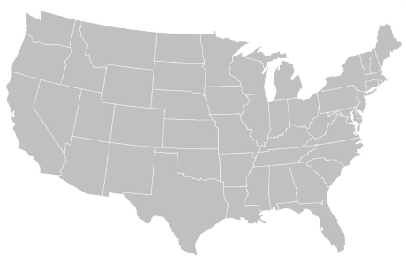





Contract Team
Prime Contractor
ESAero Inc.
TMC
Motors/Controllers
Joby Aviation
Mod III Wing Design & Fabrication
Xperimental
Joby
Mod II Integration
Scaled Composites
Battery Design & Fabrication
Electric Power Systems (EPS)
Zone 5
Software V&V
TMC
Airframe
Tecnam
ESAero
Scaled Composites
Electric Power
Systems
Xperimental
High Lift Motors
Zone 5
NASA AFRC has Phase III Small Business Innovation Research (SBIR) indefinite delivery/indefinite quantity (IDIQ) contract with ESAero Inc.
  NASA AFRC manages Phase III SBIR IDIQ contract with ESAero
  ESAero manages all subcontracts with suppliers

Slide 7
Why Electric Propulsion?
Electric motors are approximately 3x more efficient that internal combustion engines
  Typical internal combustion engines are 30% to 40% efficient
  Electric motors are 90% to 95 % efficient
Electric motors are simple
  Internal combustion engines are complicated machines
  Electric motors are easier to build, have fewer moving parts, more reliable, require less maintenance and cheaper to operate
Electric motors have a higher power to weight ratio
  Power is scalable with size for electric motors
  Can be placed anywhere on the aircraft to improve efficiently
Power remains constant on electric motors at all altitudes
  Power decreases on internal combustion engines as altitude increases due to less oxygen for combustion
Electric motors are environmentally friendly
  Dramatic reductions in energy use and carbon emissions to be part of a sustainable transportation future
  Low noise

Slide 8
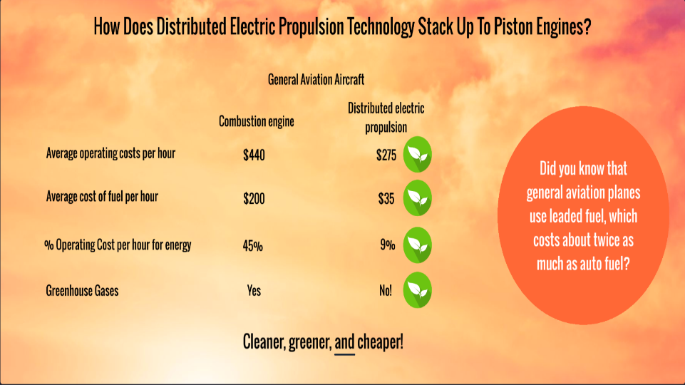

Slide 9
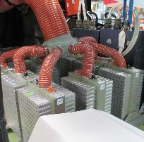
Shortcomings of Electric Propulsion Systems
Electrical energy storage and thermal issues tend to be biggest challenges
  Much lower specific energy if battery used; additional mass penalty if hybrid or onboard generation used
  Little existing ground infrastructure for energy service, maintenance, etc.
  Low temperature components – challenging cooling paths
  New safety concerns, uncertain certification path
X-57 batteries
860 pounds
56 kWh of energy
65 watt hours/lb
1 gallon of gas
6 pounds
33 kWh
5500 watt hours/lb

Slide 10

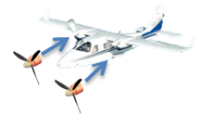
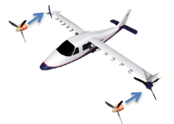


Electric Propulsion and the X-57
Mod I: Ground testing of the DEP High Lift System and Flight Testing of the bassline Tecnam P2006T | Mod II: Retrofit a baseline General Aviation aircraft with an electric propulsion system. | Mod III: Modify the configuration with an cruise-optimized wing and distributed electric propulsion system. | Mod IV: Design for adequate low speed takeoff and landing characteristics with an integrated DEP system.
Mod I provides baseline data Provides data for validation of the DEP High Lift System models; Provides baseline energy data for a stock Tecnam with internal combustion engines | Mod II reduces risk for Mods III and IV: Optimize the design for cruise power consumption with a target of 3.3x reduction in energy from the baseline aircraft. | Mod III provides cruise speed data for DEP designs, technologies and systems: Optimize the design for improved cruise power consumption with a target of 1.5x reduction in energy from the mod II configuration. | Mod IV provides low speed data for DEP designs, technologies and systems: Design the integrated system to have a minimum controlled flight speed of 58 KCAS or less while maintaining acceptable pilot workload and handling qualities.
Complete
In Progress

Slide 11


Add Drag to Lose Drag!
Modern jetliners use complex, multi-segmented flaps and slats to increase maximum lift coefficient
Enables smaller wing in cruise
Requires large external flap tracks
  Added drag from flap track fairings more than offset by reduced drag by having smaller, more heavily loaded wing
Unfortunately, scale of smaller aircraft generally precludes use of sophisticated flap systems
B757 in cruise configuration
B757 in landing configuration

Slide 12
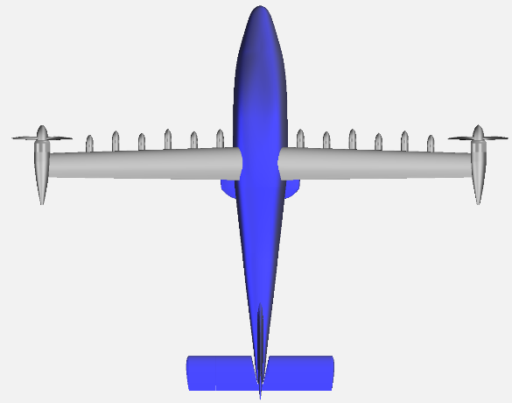
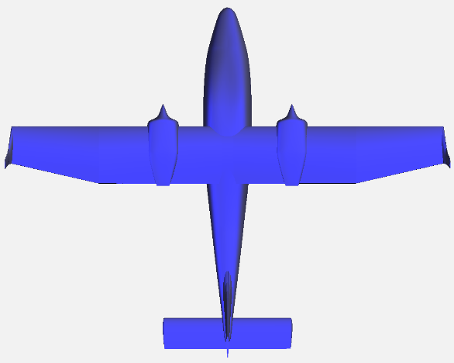
P2006T → X-57
Tecnam P2006T Wing
Loading: 17 lb/ft²
Area: 159 ft²
C_{Lmax}: ~1.7
NASA DEP Wing
Loading: 45 lb/ft²
Area: 66.7 ft²
C_{Lmax}: > 4
Impact
Large Reduction in Wing Area
Decreases the Friction Drag
Allows Cruise at High Lift Coefficient
Less Gust/Turbulence Sensitivity
Same Takeoff/Landing Speed

Slide 13
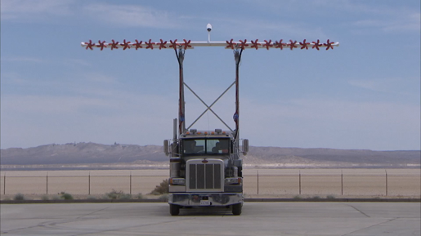
“High-Lift” Propellers
Can use propellers to “trick” wing into flying at locally faster speed
Not a new idea, but well-suited to electric motors
  High power/weight ratio at small scale
  Limited support needed (fuel lines, oil tanks, shafts/gearing, etc.)
  More torque available at low RPM enables low-noise designs

Slide 14
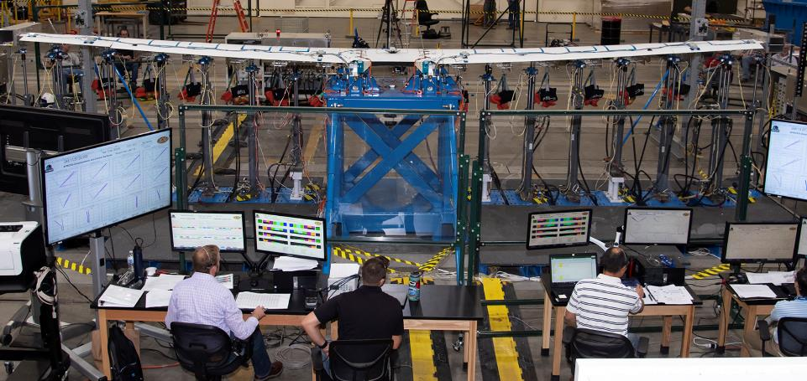
Load Test of the X57 Wing at AFRC

Slide 15

Effect of Wingtip Vortex
Lift-producing wings introduce a series of vortices, generally most pronounced at the wingtip, during flight
The effect of this is more pronounced on clean configurations with high span loads
Flying closer to maximum L/D increases drag contribution of wingtip vortex

Slide 16
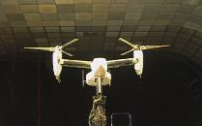
Wingtip-Mounted Propellers
NASA investigated wingtip propellers in the 1980s as a way to decrease installation losses and drag with wingtip vortex energy
Benefits of wingtip propellers apparent, but did not outweigh penalties of installing combustion engines at wingtips
Properties of electric motors warrant re-investigation, but some problems remain
  Engine-out handling
  Crosswind landing

Slide 17
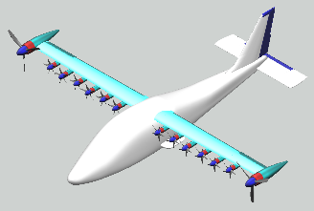
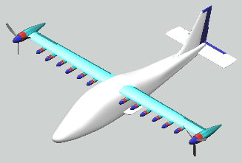
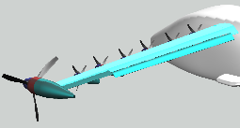
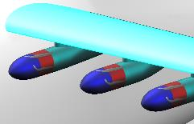
X-57 Walkaround
Landing Configuration*
Cruise Configuration
2x Wingtip Cruise Motors (each 95 hp max, 80 hp max continuous) & Propellers (5 ft diameter)
Tecnam P2006T Fuselage & Tail
3,000 lb Gross Weight
32.8 ft Span
(36.6 ft w/ Props)
150 KTAS Cruise at 8,000 ft MSL
58 KCAS Stall
(73 KCAS Unblown)
167 KCAS Max Level Flight Speed
15,000 ft Ceiling
12x High-Lift Motors (each 14 hp) & Propellers
(1.9 ft diameter)
*Landing Gear Omitted for Clarity
30-Degree Fowler Flap
High-Lift Propellers Stowed for Cruise

Slide 18
Motivation for X-57 Mod II; Retiring Electric Propulsion Barriers
Advance the Technology Readiness Level for aircraft
electric propulsion. Aerospace has weight, safety, and
flight environment challenges which complicate
adaptation of COTS technologies
  X-57 needs high voltage lithium batteries with intrinsic
  propagation prevention and passive thermal management
  Establish motor/inverter ground and flight test program
  Design crew interface and human factors approach to
  manage workload for complex propulsion systems
Pathfinder for aircraft electric traction system standards.
Lessons learned used to inform FARs and standards
Reduces electrified system development risk for Mod III and IV
through early testing on a proven vehicle configuration
Develop capability within NASA to design, analyze, test, and fly electric aircraft
The value of X-57 lies in advancing the Nation’s ability to design, test, and certify electric aircraft, which will enable entirely new markets (UAM)

Slide 19
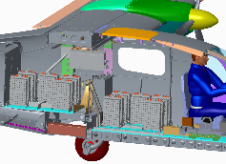
X-57 Flight Batteries Technical and Testing Challenges
No commercial solutions existed for battery systems with sufficient energy and power to provide meaningful aircraft flight duration.
  High power requirements within a "flight-weight" limitation- 538 V, 57 kWh effective capacity, 859 lbs. (16 Modules, 51 lbs. each).
    Aircraft propulsion requirements drive design solutions to a higher voltage and current than comparable automotive or auxiliary aircraft operations.
    Advancing the system-level state of the art for an aircraft battery from TRL 4 to 6.
  Industry target of 30% packaging overhead aligns with X-57 mass budget.
  Thermal management is a critical design driver and key X-57 design trade-off.
    X-57 battery system is passively cooled to minimize complexity.
    Production battery systems require active cooling.
  Battery management software and control system had to be developed
    Not accounted for in most battery weight and performance specs.
  No large, high density COTS battery packs prevent thermal runaway propagation.
    Original X-57 battery design failed to contain a failure propagation test (December, 2016)
    Battery System re-designed to contain single-cell failures, prevent cascade failures.
    Thermal runaway gas and ejecta containment drives sealed designs and increased weight.
  Battery module/system test approach informing standards (ASTM F39.05 WK56255)
Forward Traction Battery and Venting System
Cutaway showing battery installation (10 of 16 modules)

Slide 20
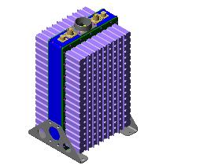

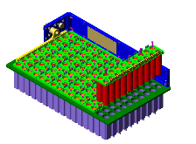


Traction Battery Redesign
Battery Module 20P-16S
2 Sub-Modules
320 Cells
57.6 Volts
60 Ah - 3,456 Wh
Battery 20P-128S
8 Modules
2560 Cells
461 Volts
60 Ah - 27,648 Wh
Sub-Module 20P-8S
8 Bricks
160 Cells
28.8 Volts
60 Ah - 1,728 Wh
20P-1S Brick
20 Cells
3.6 Volts (Nominal)
60 Ah - 216 Wh (0.2C)
Cell Voltage | Battery Voltage | State
4.2 | 537.6 | Fully Charge
4.15 | 531.2 | EPS Recommended Stop Charge
3.6 | 461 | Nominal Voltage
3.25 | 416 | EPS Recommended Stop Discharge
2.5 | 320 | Discharge End Voltage
X-57 Requires 2 Batteries (Battery A and Battery B)
16 Modules
5120 Cells
461 Volts Nominal for Each Battery
60 Ah - 27,648 Wh for Each Battery
Battery Controller Module (BCM)
One required for each traction battery

Slide 21
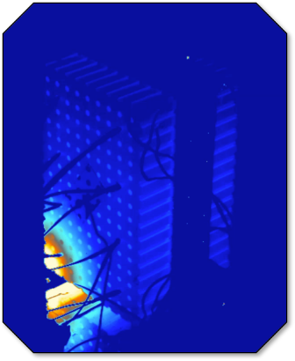
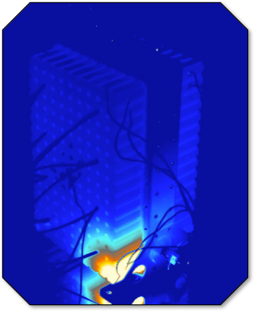
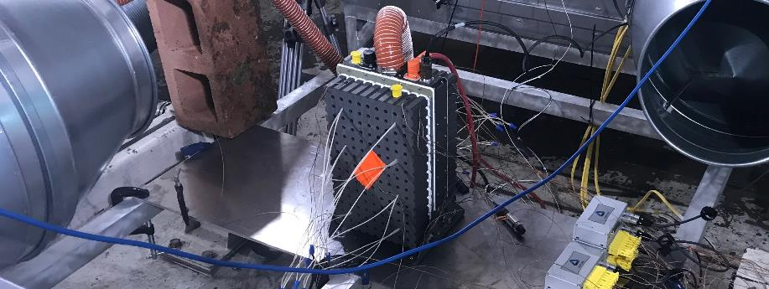
2nd Generation X-57 Battery Single Cell Short Circuit/Thermal Runaway Without Propagation
X-57 Thermal Propagation Test Module (316 flight-like cells, 4 “Trigger Cells” with internal shorting devices)
FLIR Video of Trigger Cell #4 Event (8x speed)
FLIR Video of Trigger Cell #3 Event (8x speed)
http://go.nasa.gov/2iZ5lYi

Slide 22
Cruise Motor Manufacturing and Testing Challenges
Flight motor is Rev K of the design; 11th major design iteration. (AIAA 2016-3925)
Passively cooled electric motor presents testing and analysis challenges. (AIAA 2017-3783, 3784)
Determining motor performance (efficiency and torque) difficult due to EMI and high frequencies.
Motor assembly is a laborious process.
  Was not expected for a mechanically simple system.
Test program has successfully identified some assembly workmanship/design weaknesses; redesign/rebuild plan in place.
Damage to stator wiring from contact with mounting bolts
Self-induced vibration exposes insulation overstress areas efficiently
Redesign by integrated NASA and Contractor team to incorporate flight experience and rapid iteration

Slide 23
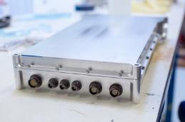
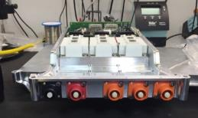
Cruise Motor Controller (CMC) Technical Challenges
Electric aircraft operation requires high-efficiency power conversion from the battery to the motor, which is pushing the state of the art.
  This conversion is handled by the cruise motor controller (CMC).
Technical Challenges
  Si-C MOSFET (Silicon Carbide Switch) is a TRL 3 technology, required to achieve high switching frequencies necessary for aerospace efficiency requirements.
    A vendor has indicated this technology is not yet ready for aircraft applications.
    X-57 is working with our vendor to develop the technology.
  Si-C MOSFET technology is sensitive to non-optimized power distribution, which causes challenges with testing and system architecture.
  Level 1 Safety Critical software required, new for this type of application.
    Redundant architecture (required to manage wingtip asymmetric thrust case) introduces complex dual-controller software startup race condition handling
  Air cooled heatsink efficiency is critical to efficient operation, and the design required multiple design iterations.
Flight CMC prototype
DC Power is filtered with large capacitor circuit before high-speed SiC module interface

Slide 24
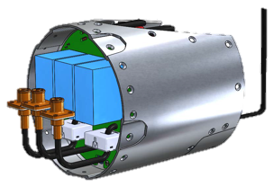
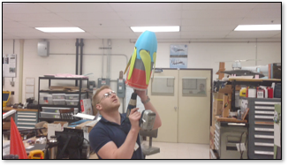
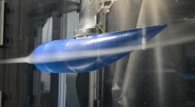
High Lift/Distributed Electric Propulsion System
High-lift propeller designed very differently from traditional propellers
  Uniform velocity profile vs. most efficient thrust velocity profile
  Fold to minimum drag position when not in use
  Low-noise features (blade count, tip speed)
Operation while landing a driver for number, diameter of propellers
  More tends to be better
CFD indicates wing and propeller design will meet or exceed requirements for stall speed
Critical design and prototype phase underway
Mod IV High Lift Nacelle
High Lift Motor Controller
Rapid Prototype 3-d Printed Model of the Initial High Lift Folding Propeller
CFD Model For Initial High Lift Folding Propeller Blade Performance

Slide 25
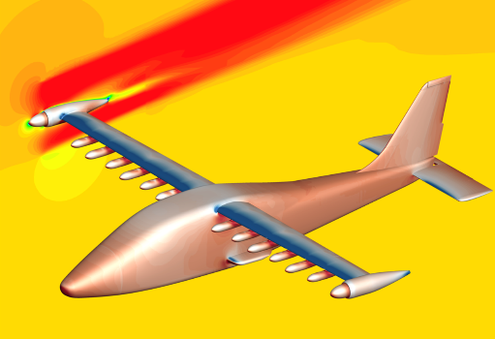
Aerodynamic Models
In order to understand the aerodynamic effects of this design, a team of engineers at Ames, Langley and Armstrong are using supercomputers to simulate flight conditions for the X-57.
These simulations help the team analyze the aircraft’s stability and its ability to stay in flight and change direction and will also allow them to create an accurate computer model of aerodynamic performance to incorporate into the X-57 flight simulator.
Model data correlated with wind tunnel data
The aerodynamic model ensures that its flight simulator performs in a manner consistent with actual flight and lets pilots test emergency scenarios and safe recovery measures
Cruise phase of flight, with pressure shown on the aircraft surface (maroon: high pressure, dark blue: low pressure) and streamwise velocity, or the speed and direction of air flowing toward the aircraft, near the X-57’s rightmost propeller (top left of image; red: high velocity, green/blue: lower velocities).

Slide 26
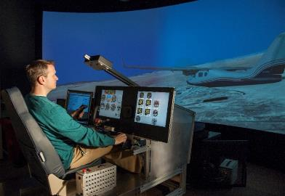
Flight Controls and Simulation
Allow pilots to train in flight-like environment
Includes failure scenario modeling (e.g. engine out)
Pilot feedback is used for design changes
Piloted Simulator at AFRC Includes Flight Like Instrument Panels, Switches, MFD

Slide 27
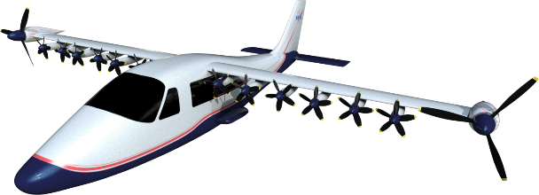
Conclusions
X-57 is designed to showcase Distributed Electric Propulsion Technology – namely, how electric airplanes will need to differ from “traditional” designs
Flight test program designed to retire risk in systematic way; first flights of Mod II planed in 2020
Already seeing impacts on U.S. Aviation Industry

Slide 28
Backup

Slide 29
Electrified Architecture with Redundancy
Dual inverter reduces failure severity
High voltage contactors required for hazard segmentation
Independent battery packs enables powered landing after cell failure

Slide 30
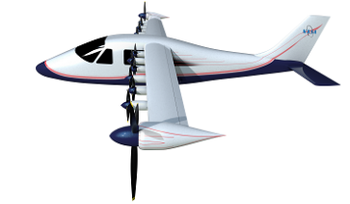
Motivation for X-57 Mod III/IV; Leveraging Distributed Electric Propulsion
Matures Distributed Electric Propulsion system architectures
  NASA will tackle technical challenges operating multiple motors in configurations relevant to industry (UAM, Thin Haul)
  Validates higher power electric propulsion system operation (120 kW in Mod II → 250 kW in Mod IV)
  Pathfinder for certification of complex DEP systems
Exploration of novel, optimized configuration enabled by DEP (Thin Haul and larger scale)
  Exploration of wingtip propulsion/vortex interaction
  Cruise-optimized wing enabled by blown high-lift system
  High performance, high aspect ratio wing requires new wing material structure system
Optimized DEP configuration enables significant improvement to aircraft performance not currently explored in the marketplace
  Goal is 500% improvement in energy consumption at cruise
  Zero In-flight Carbon Emissions
  Opportunity for significant noise reduction
Mod III/IV will explore the benefits of Distributed Electric Propulsion which will revolutionize aircraft architecture and performance

Slide 31
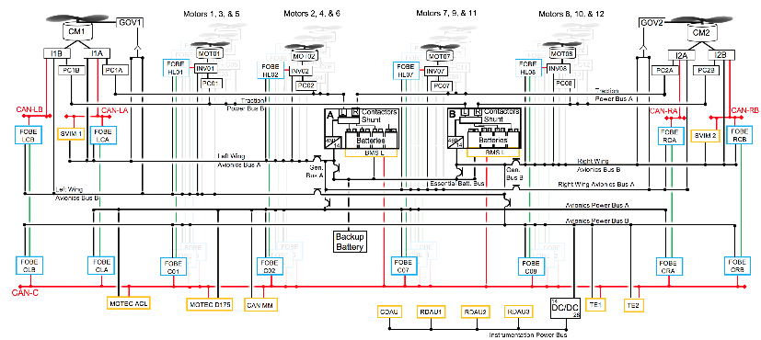
Power and Command Interconnection Diagram
Large number of interfaces even for "simple" vehicle architectures
Failure Analyses and Tests validate redundancy and segmentation approach

Slide 32
Lessons Learned and Tech Transfer Opportunities
Stakeholder/ Technology Area | FAA | ASTM, SAE | Vertical Lift Technologies (eVTOL) | On Demand Mobility (UAM) | Electric Transport Aircraft
Certification Basis | Part 23, 33 | Top-Level Standard | Part 23 Lessons for Part 27 & Part 33 | Part 23/33 for 21.17(b) | Part 23/33 Lessons for Part 25
Batteries | MOC | Standards | Lessons Learned | Lessons Learned | Lessons Learned
Motors | MOC | Standards | Lessons Learned | Lessons Learned | Lessons Learned
Motor Controllers | MOC | Standards | Lessons Learned | Lessons Learned | Lessons Learned
Aero Perf. | MOC | Standards | Wing-Borne Transition | Wing-Borne Transition | Lessons Learned
Human/Aircraft Integration | MOC | Standards | Elec. Health Display/Control | Elec. Health Display/Control | Lessons Learned
Distributed Propulsion | MOC | Standards | Power Distribution/Control | Power Distribution/Control | Lessons Learned
MOC: Means of Compliance
Table shows technical transfer product outreach paths to electric aviation industry
X-57 Deputy Project Manager joined ASTM F44 Executive Committee
NASA SMEs participating on subcommittees for General Aviation and Powerplants
Coordinating with other ARMD Projects, FAA, and Standards bodies share relevant X‑57 research and technology
X-57 technologies and experience are good candidates for tech transfer to broad swath of electric aviation industry

Slide 33
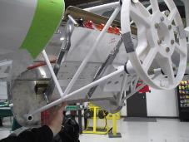
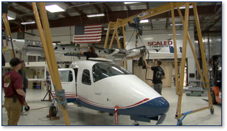
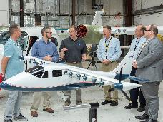
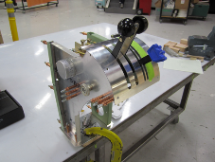
Mod II Vehicle Integration
Cruise Motor Mount and Torque Controllers (Inverters)
Cruise Motor Nacelle & Cowling
Sensors installation: strain gauges, accelerometers, air data probe
Cockpit modifications: digital display, throttles
Motor integration: mounts installed, cowling and ducting fabricated
NASA Administrator Bridenstine Inspecting X-57 Maxwell
Digital Throttle Quadrant
Mod II Wing installation

Slide 34
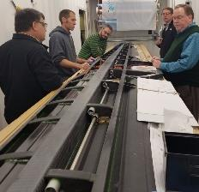

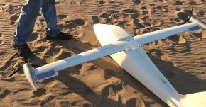
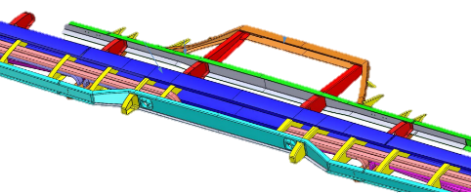
Mod III Wing Design
Composite wing fabricated at Xperimental/California
Single, continuous main spar carries normal and axial loads (shear and bending)
Working skin–buckling free–carries torsional loads
Front and rear spars receive external loads (nacelles and controls)
Isostatic attachment to the fuselage. No moment transferred with wing bending
Mod III wing:
Bottom Skin, Rear Spar
Aileron, Flap, High Lift Nacelle Interface
Mod III Spar/Rib Layout,
Power and Instrumentation Ducts
Remote Control Quick Look Stability & Control Model

Slide 35
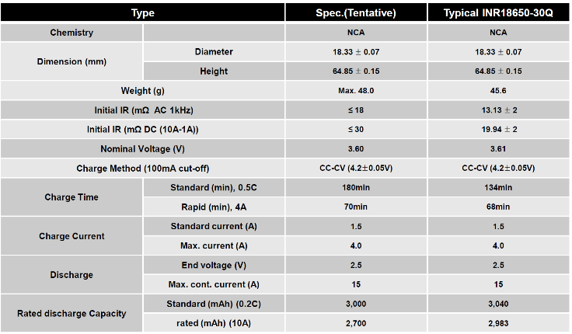
INR18650-30Q Spec

Slide 36
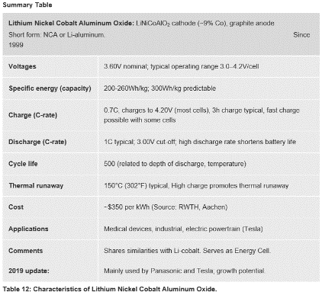
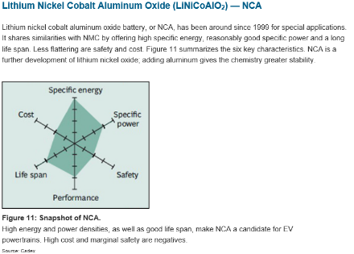
INR18650-30Q Spec

Slide 37


