Slide 1
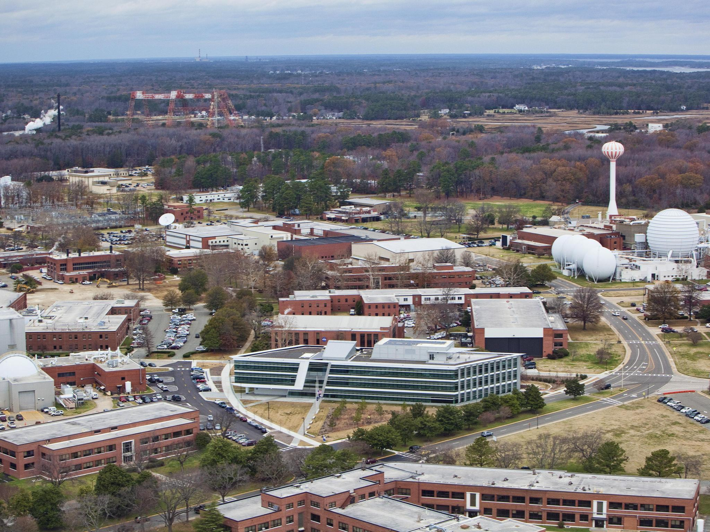
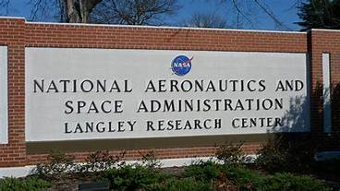
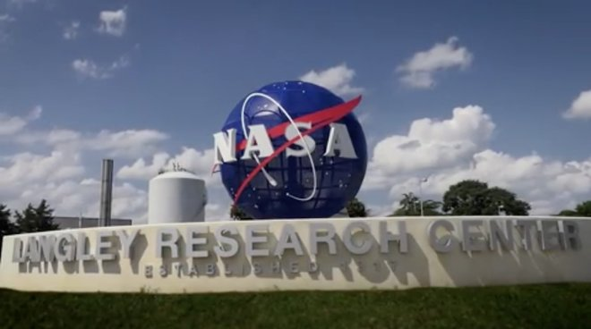
Langley Contractor Steering Council (LCSC)
February 20, 2020

Slide 2
Welcome
Good afternoon.
Happy President’s Day! Hope you enjoyed the long weekend, it’s the last one for awhile.
Before we get started, I’d like to see if VASBA has anything they’d like to share.
Does anyone have anything else?

Slide 3
LCSC Meeting Agenda
Welcome and announcements
Small Business Update
NASA SBIR/STTR Phase 1 – Kim Cannon
Active Shooter Response
Closing

Slide 4
LCSC Small Business Update
Robert Betts
Langley Research Center
Small Business Specialist
February 20, 2020

Slide 5
NASA Agency January FY20 Prime Goals vs. Actual Percentages Data generated February 6, 2020 from FPDS-NG

Slide 6
LaRC January FY20 Prime Goals vs. Actual Percentages Data generated February 6, 2020 from FPDS-NG

Slide 7
Upcoming LaRC Procurement Opportunities
Name of Procurement | NAICS Code | Est. Dollar Value | Set-Aside | Est. RFP/RFQ Release | Remarks
Occupational Health | 621999 | $5M-$50M | 8(a) Competitive | 2/18/2020 | Current contract ends: 04/30/2020 Current Contract: 8(a) competitive Status: RFQ 80LARC20Q0001
X-59 Community Response Testing | 541715 | $5M-$50M | TBD | FY2020 2nd Qtr. | New requirement Status: SS-X59CRT Requirement Development / Market Research
Evaluations, Assessments, Studies, Services Support 3 (EASSS 3) | 541715 | $50M+ | Total SB set aside | 2/27/2020 | Current contract ends: 09/23/2020 Current Contract: SB set aside Status: RFP 80LARC20R0002
Basic and Applied Aerospace Research and Technology 2 (BAART 2) (Multiple award IDIQ) | 541712 | $50M+ | TBD | FY2020 2nd Qtr. | Current contract ends: 10/31/20 Current Contract: Partial SB set aside Status: No update
Geospatial Support Services (GSS) | 541370 | $5M-$50M | TBD | FY2020 3rd Qtr. | Current contract ends: 11/30/20 Current Contract: HUBZone set aside Status: Market Assessment
Simulation and Aircraft Services (SAS) | 541330 | $5M-$50M | TBD | FY2020 3rd Qtr. | Current contract ends: 02/28/21 Current Contract: Full & open Status: Market Assessment

Slide 8
Other Opportunities
Name of Procurement | Response Date | Point of Contact | Remarks
Partnership Opportunities for Earth Venture Instrument for SmallSat/CubeSat Lidar Measurements | 2/28/2020 | JaeSun Riley (757) 864-8306 Jaesun.k.riley@nasa.gov
Metallic Metals Blanket Purchase Agreement (BPA) | 2/28/2020 | Sharon Hare (757) 864-2409 Sharon.v.hare@nasa.gov | RFQ 80LARC20Q0002 NAICS 423510 Total SB Set aside
Advanced Metallic Manufacturing Approaches for Commercial Transport Fuselage Structures | 3/2/2020 | Liliana Richwine (757) 864-2478 Liliana.j.Richwine@nasa.gov | RFI 80LARC-RFI-AL-Fuselage-Assem NAICS 541715
NASA SBIR/STTR Phase I Solicitation 2020 | 3/20/2020 | Kim Cannon (757) 864-3814 Kimberly.a.cannon@nasa.gov | Selection on 6/10/2020 Sbir.nasa.gov
Multiple Technology Transfer Opportunities | Various | Krista Jensen (757) 864-3346 Krista.y.Jensen@nasa.gov | See beta.SAM.gov for opportunities

Slide 9
Upcoming Webinars & Podcasts
Date | Topic | Guest
April 15, 2020 | The Reboot of the NASA Mentor-Protégé Program | David Brock Small Business Specialist/Program Manager Marshall Space Flight Center
June 17, 2020 | The Ins and Outs of Bid Protests | Lisette Washington Attorney Advisor NASA Office General Counsel
Webinars and podcasts are FREE and open to the public!
Register today at bit.ly/OSBPwebinars.

Slide 10
Upcoming Outreach Events
NASA Engagement Forum & SB Symposium at CIAA
Charlotte, NC – February 26-27, 2020 (18 Universities registered)
2020 Society of American Military Engineers (SAME) Small Business Outreach and Industry Day
Renaissance Hotel, Portsmouth, VA – March 19-20, 2020
Countdown to Success Supplier Summit and STEM Experience
Charleston, SC – March 25, 2020
USCG Command, Control and Communications Engineering Center (C3CEN) Industry Day
Doubletree Hotel, Norfolk Airport – April 2, 2020
NASA HBCU/MSI Technology Infusion Road Tour at Morgan State University
Baltimore, MD – April 21-22, 2020
National Veterans Small Business Coalition (VETS 20)
San Antonio, TX – May 26-29, 2020
Northwest Aerospace Defense Conference
Seattle, WA – June 11, 2020
NASA KSC Business Expo
Port Canaveral, FL – October 7, 2020

Slide 11
NASA Langley Research Center Contact Information & Links
Robert Betts
Small Business Specialist
Tel: (757) 864-6074
Email: larc-SmallBusiness@mail.nasa.gov
Website: www.osbp.nasa.gov
NASA Vendor Database: https://vendors.nvdb.nasa.gov
NASA Partnerships: www.nasa.gov/partnerships
NASA Tech Transfer: http://technology.nasa.gov
NASA SBIR/STTR: www.sbir.nasa.gov
2019 NASA Langley Research Center Annual Report: https://issuu.com/nasalangley/docs/2019_nasa_langley_annual_report
NASASmallBusiness
@NASA_OSBP
NASAOSBP

Slide 12
NASA SBIR/STTR Phase 1 – Kim Cannon

Slide 13
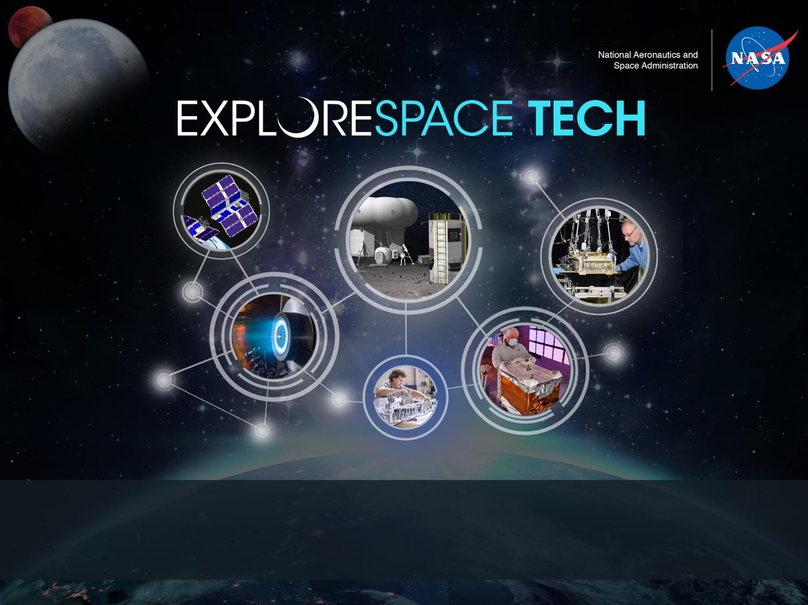
Small Business Innovation Research Small Business Technology Transfer
Kim Cannon | NASA SBIR/STTR Brief Program Overview | February 20, 2020

Slide 14
SBIR/STTR Program Structure
Go to sbir.nasa.gov/guide for details

Slide 15
Learning about NASA’s Needs
NASA’s research subtopics are organized by “Focus Areas” that group interests and related technologies.
Identify the Area(s) closest to your innovation/idea
Go to our website to research
Prepare to write a proposal tailored to NASA’s needs
FA 1: In-Space Propulsion Technologies | FA 9: Sensors, Detectors and Instruments | FA 17: Thermal Management Systems
FA 2: Power Energy and Storage | FA 10: Advanced Telescope Technologies | FA 18: Air Vehicle Technology
FA 3: Autonomous Systems for Space Exploration | FA 11: Spacecraft and Platform Subsystems | FA 19: Integrated Flight Systems
FA 4: Robotic Systems for Space Exploration | FA 12: Entry, Descent and Landing Systems | FA 20: Airspace Operations and Safety
FA 5: Communications and Navigation | FA 13: Information Technologies for Science Data | FA 21: Small Spacecraft Technologies
FA 6: Life Support and Habitation Systems | FA 14: On-Orbit Servicing, Assembly, and Manufacturing (OSAM) | FA 22: Low Earth Orbit Platform Utilization and Microgravity Research
FA 7: Human Research and Health Maintenance | FA 15: Materials, Materials Research, Structures, and Assembly | FA 23: Digital Transformation for Aerospace
FA 8: In-Situ Resource Utilization | FA 16: Ground and Launch Processing | FA 24: Dust Mitigation
https://sbir.nasa.gov/solicitations

Slide 16
Program Status
2019 SBIR/STTR Phase II
Feb 5, 2019: 2019 SBIR/STTR Solicitation was released
Feb 18, 2020: 2019 SBIR Phase II Proposals are due
LaRC is responsible for 53 SBIR Phase I awards. There were 316 total awards.
May 14: 2019 SBIR Phase II Selections will be announced
Sept 21: 2019 STTR Phase II Proposals are due
LaRC is responsible for 7 STTR Phase I awards. There were 48 total awards.
Nov 24: 2019 STTR Phase II Selections will be announced
2020 SBIR/STTR Phase I
Jan 21: 2020 SBIR/STTR Solicitation was released
March 20: 2020 SBIR/STTR Phase I Proposals are due
The SBIR/STTR program received over 1,600 2019 Phase I proposals.
June 10: 2020 SBIR/STTR Phase I Selections will be announced
https://sbir.nasa.gov/solicitations

Slide 17
Program Status
2020 Civilian Commercial Readiness Pilot Program (CCRPP)
The SBIR Program will match between $500K and $1M on 2010-2015 Phase II awards for an additional two-year award.
Dec 16, 2019: 2020 CCRPP Proposals were due
Mar 20, 2020: 2020 CCRPP Selections will be announced
2020 Lunar Sequential Phase II
Eligible companies were invited to submit proposals to support the Agency’s ability to land humans on the moon in 2024 and support a sustainable presence there by 2029, with an elevated award value from $2.5-5M
Jan 31: 2020 Lunar Sequential White Papers were due
May 25: 2020 Lunar Sequential Proposals are due
July 1: 2020 Lunar Sequential Selections will be announced
https://sbir.nasa.gov/solicitations

Slide 18
Contact us and let’s innovate together
Website
www.sbir.nasa.gov
Sign up for our Newsletter
https://sbir.nasa.gov/info
NASA Help Desk
301.937.0888

Slide 19
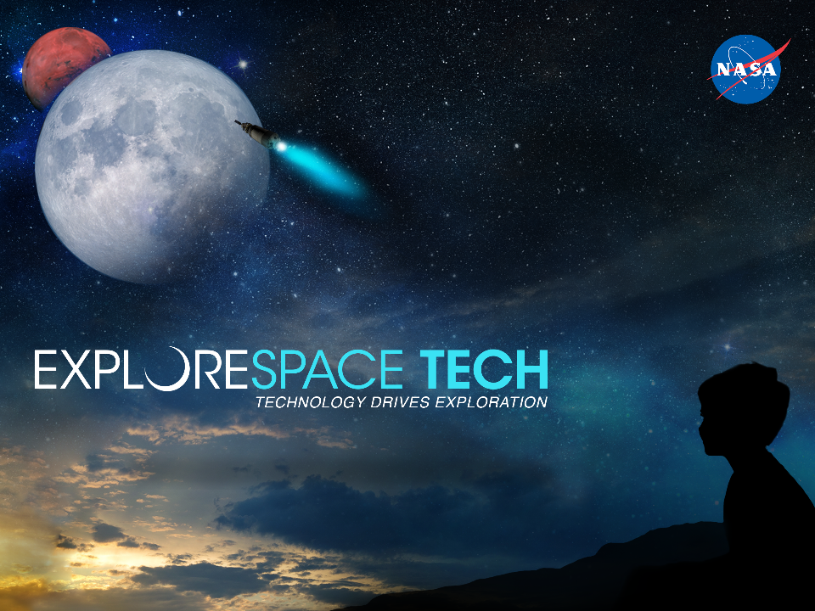

Slide 20
Active Shooter Training

Slide 21
Thanks for coming out today!

