Slide 1
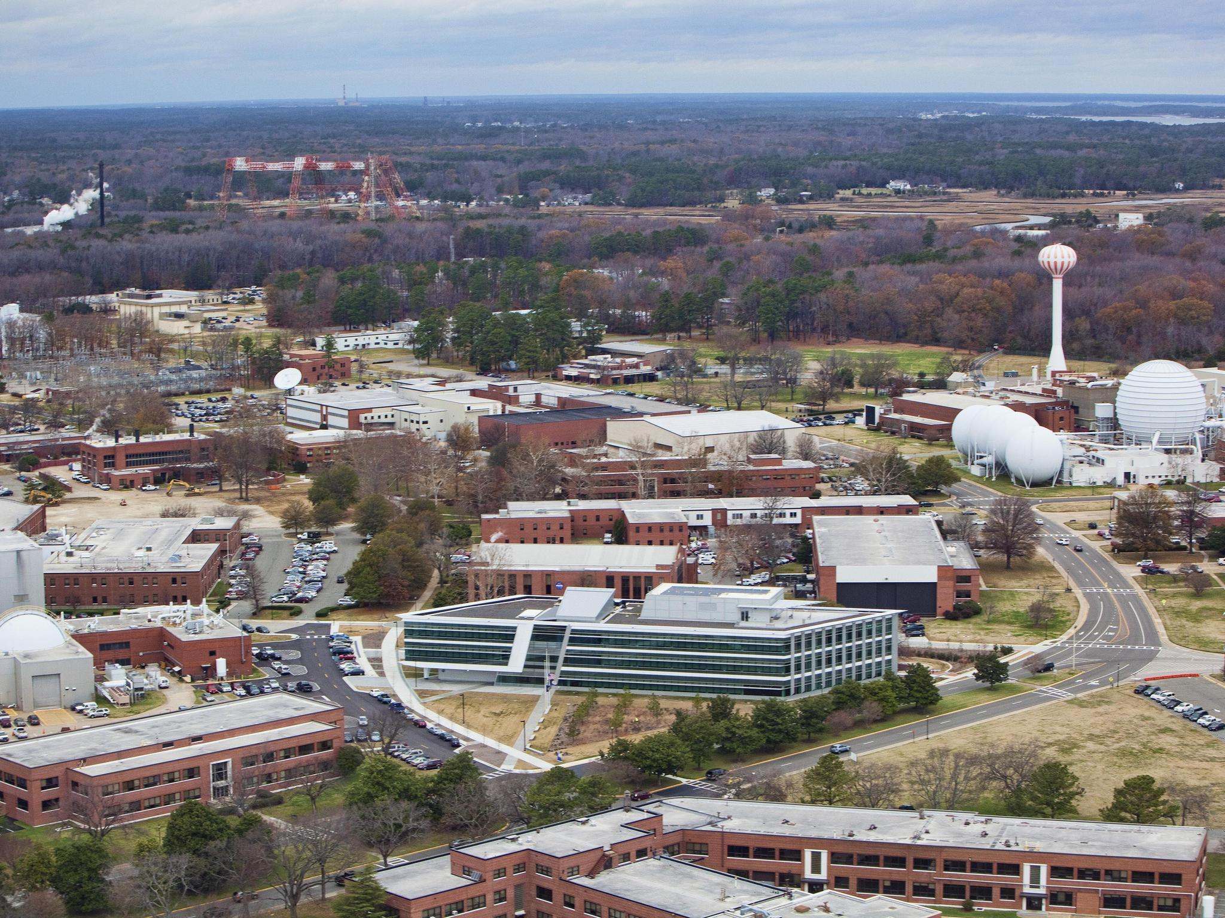
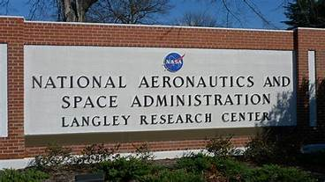
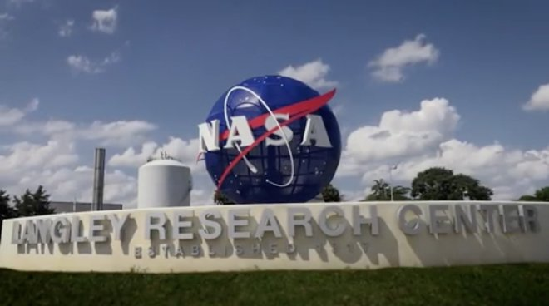
Langley Contractor Steering Council (LCSC)
December 11, 2019

Slide 2
Welcome
Good afternoon, thanks for coming out.
We’re knee deep into the holiday season with Christmas just two weeks away. If traveling be safe.
This is our annual LCSC Holiday Luncheon, if you haven’t already, please grab something from the cafeteria.
Before we get started, I’d like to see if VASBA has anything they’d like to share.
Does anyone have anything else?

Slide 3
LCSC Meeting Agenda
Welcome and announcements
Eat
X-57 – Keith Harris
Soliciting committee members for the communications committee.

Slide 4
X – 57 The Maxwell Project or SCEPTOR Keith Harris

Slide 5
Soliciting committee members for: Communications Committee Will send out an email asking for volunteers

Slide 6
Thanks for coming out today!

