Slide 1
KEYS to Creativity and Innovation
NASA Langley Research Center
……………………………………………………….
3 October 2011

Slide 2
LaRC Mission Strategy

Slide 3
KEYS to Creativity and Innovation…
A tool to help leaders see a clear picture of the work climate within a work group or organization.
That climate, also known as the work environment, greatly influences an employee’s ability to be creative.
The value of KEYS lies in its capacity to accurately identify the conditions necessary for innovation to occur.
Notes:
Goals and Outcomes for Implementing KEYS Organizational Assessment
Provide a realistic view of the management practices that drive and inhibit creativity and innovation.
Establish a baseline for improvement and goal setting.
Create a plan of action, based on the KEYS data, to improve the innovative culture.
VALIDITY
KEYS can reliably distinguish between a corporate work environment that produces higher innovative results from one that does not, in both technical and non-technical work.
KEYS dimensions are significantly correlated to the norm group. Work environments that produce high creativity projects and seen as innovative are rated higher on KEYS scales.
KEYS contains a built in validity assessment and includes two criterion measures on the quality of the work: creativity and productivity.

Slide 4
KEYS to Creativity and Innovation…
FedView Survey
Describes the work environment for creativity and innovation:
Management Practices
Organizational Motivation
Resources and Workload Pressure
Outcomes – Creativity and Productivity
Answers the question: “what are the current levels of stimulants and obstacles to creativity and innovation that exist in my work environment?”
Addresses three Human Capital Assessment Accountability Framework systems (HCAAF):
Leadership/Knowledge Management
Results-Oriented Performance
Talent Management
Answers the question: “do I want to join, stay and help the agency meet its mission?”

Slide 5
KEYS to Creativity and Innovation…
Factors/Scales
Freedom
Challenge
Managerial Encouragement
Work Group Supports
Organizational Encouragement
Lack of Organizational Impediments
Sufficient Resources
Realistic Workload Pressure
Outcomes – Creativity and Productivity

Slide 6
Impact of the Work Environment
resources
management practices
Work Environment
Innovation
I
organizational motivation
Implementation
Individual/Team
Creativity
expertise
creativity
skills
C
Creativity
intrinsic
motivation
Notes:
Creativity – lies within the individual; people are creative
Creativity is defined as the production of novel and appropriate ideas by individuals or small groups
Individual creativity depends upon their level in three domains:
Expertise – knowledge, talent and skill (KSA’s) in the particular area where the individual is doing creative work.
Creativity Skills – having a flexible problem-solving approach, persevering on difficult problems, and taking risks with solutions to problems.
Motivation – the desire to solve the problem or accomplish a task because it is interesting and personally challenging.
Higher levels in each domain increase an individual’s Creative Capacity!
Innovation – exists within an organizational setting such as a work group, division, function, geographical location and the entire organization. This setting, known as the culture or work environment, is where creative ideas are implemented and result in quantifiable gain. The impact that the environment has on individual creativity cannot be neglected; in fact from our research and others, we know it is a key driver of innovation!
Innovation is defined and the successful implementation of creative ideas within an organization
Innovation within the organization depends upon the work environment in three component areas:
Organizational Motivation – the basic orientation of the organization toward innovation; shared vision; providing rewards and recognition; lack of internal politics, and lack of overemphasis on the status quo.
Resources – everything the organization has available to aid in the area targeted for innovation, including time, funding, information and materials.
Management Practices – allowing freedom and autonomy in the practice of work; providing challenge; specifying clear strategic goals and forming work teams comprised of individuals with diverse skills and perspectives.

Slide 7
KEYS to Creativity and Innovation
“Most important factors…
A) Supporting
B) Inhibiting
C) To Improve
the climate for creativity and innovation.”
Notes:
KEYS identifies the most important factors that support, inhibit and suggestions for improving the climate for creativity and innovation.
Each survey participant chose from a specific list of the most common responses identified from research with thousands of respondents. These factors represent the areas of greatest concern and are especially important coming from within the organization, rather then suggestions from outsiders.

Slide 8
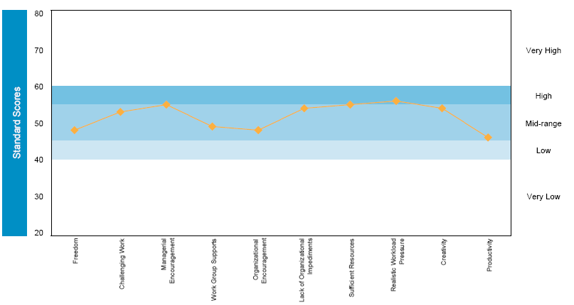
Sample Graph
Notes:
The KEYS norm group consists of 186 groups made up of 22,000 individuals and the data represent a variety of functions and departments in hundreds of different organizations.
These organizations represent a number of industries including: automotive, high tech, government, biotechnology, electronics, chemicals, pharmaceuticals, health care products, and consumer products. Various functions include: traditional research and development, engineering, marketing, sales, manufacturing, and administration.
Scoring is standardized for ease in making comparison; 10 points represents 1 Standard Deviation. 68% of the scores in the normative group fall within the shaded blue area; 16% in the Very High and 16% in the Very Low (white).
KEYS does not measure individual creativity.
KEYS assesses the work environment, i.e. the management practices, resources, motivations and interactions of a great many people.
KEYS scores are standardized and compared to a norm data base
Higher scores are always preferred.

Slide 9
KEYS Normative Group
The KEYS norm group consists of 186 groups made up of 22,000 individuals with the data representing a variety of functions and departments in hundreds of different organizations.
These organizations represent many industries including: automotive, high tech, government, biotechnology, electronics, chemicals, pharmaceuticals, health care products, and consumer products. Various functions include: traditional research and development, engineering, marketing, sales, manufacturing, and administration.
Scoring is standardized for ease in making comparison; 10 points represents 1 Standard Deviation. 68% of the scores in the normative group fall within the shaded blue area; 16% in the Very High and 16% in the Very Low (white).

Slide 10
This graph compares dimension ratings (as standard scores) to a specific normative group (detail provided in the heading). The mid-range line marks the average of the CCL normative group (a mean of 50 and a standard deviation of 10). In this graph, ratings range from 20 to 80. Because the ratings are close to normally distributed, less than 1% of ratings fall outside the 20-80 range and two-thirds of all groups will fall between 40 and 60.
Government

Slide 11
KEYS Data - Langley Research Center
Organization N=1,747
(50% Response Rate)

Slide 12
Key Findings?
What hypothesis do you have about the perceptions to creativity and innovation in the work environment at NASA Langley Research Center?
Big Picture
Executive Team
Civil Servants – Contractors
Term - Perm
Level

Slide 13
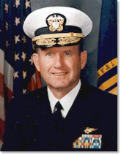
“The climate for creativity and innovation is both strong and positive. The primary elements for mission success at NASA LaRC from an innovation perspective are among the highest we've experienced”
John R. Ryan ~ CEO
Center for Creative Leadership

Slide 14
Key Findings (Overall)
The climate for creativity and innovation at NASA LaRC is viewed as positive compared to CCL’s robust normative group
The work environment supports the management practices, organizational motivation and resources needed for innovation to occur
There is low agreement about what sustains, inhibits, and suggestions for improving creativity and innovation
Across the organization, there is a perception that failure is not acceptable even when the effort is good
Some people in the organization are very concerned about protecting their territory
Some respondents feel that the budget for their specific project(s) is NOT adequate;
“insufficient money” is the largest factor inhibiting C&I and “more money” is the suggestion most cited for improving C&I
Budget was the only item rated “VERY LOW”

Slide 17
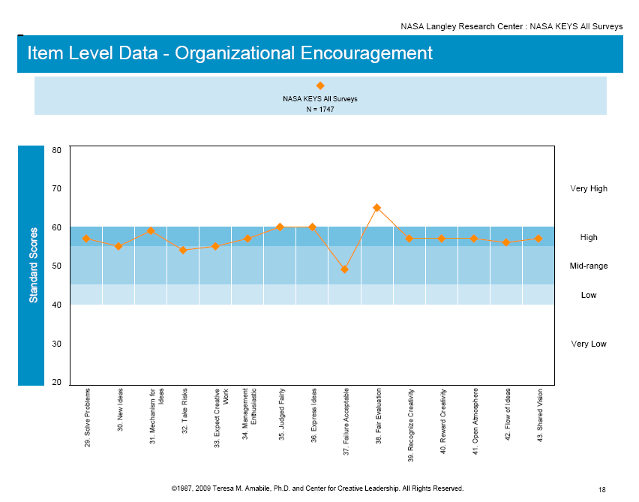

Slide 18
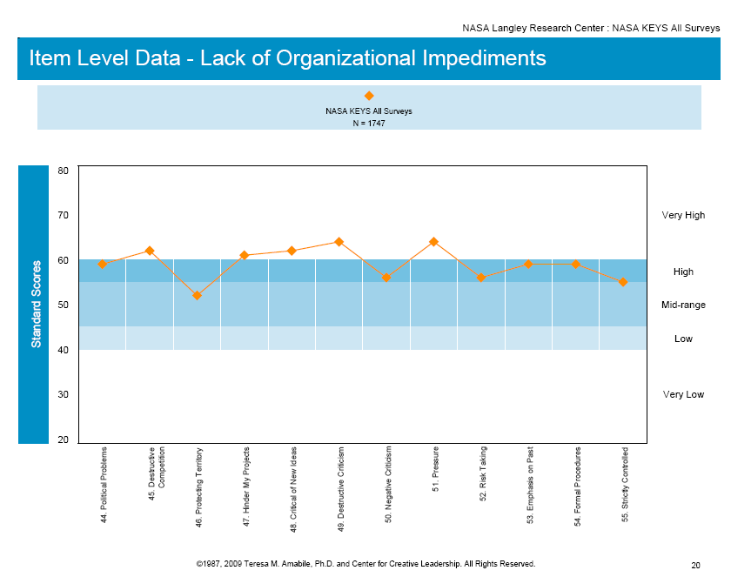

Slide 20
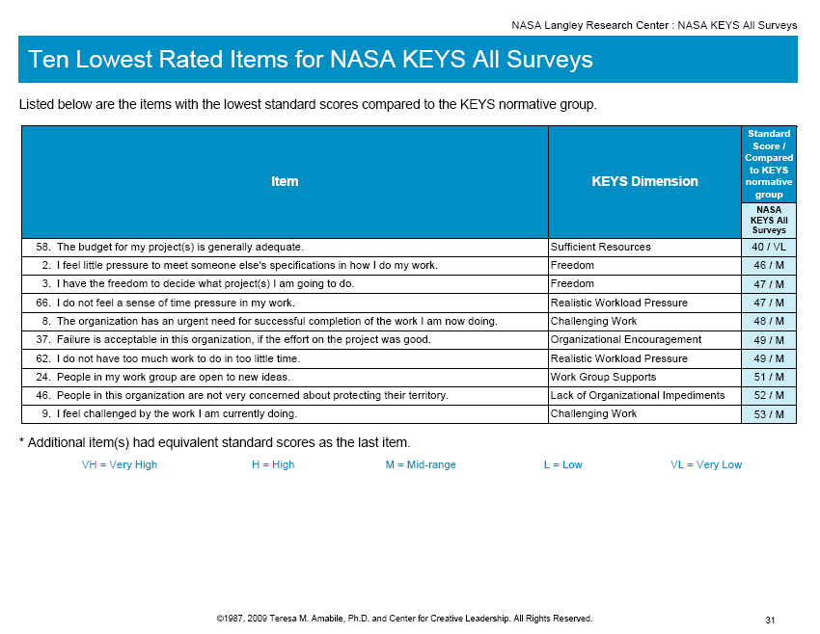

Slide 24
Key Findings (Director Level)
Director Level staff see the climate as significantly more positive in almost all respects.
Director Level staff indicated that they do not have enough time for the work that must be done and feel a greater sense of time pressure than other staff
Insufficient money was #1 factor cited as an inhibitor to creativity and innovation (42%)
A lack of trust within the team was cited (23%)
Risk avoidance was a top four inhibitor (19%)

Slide 25
KEYS Data - Langley Research Center
Directors N=26

Slide 28
Key Findings (Contractors – Civil Servants)
As compared to Civil Servants, the data are similar although Contractors report:
- that there are very few distractions from project work
- there is a good blend of skills in the work group
- they see the workload more favorably
- good team relations and blend of skills
- they are personally very creative in their work
- the budget for projects as more favorable
- a lack of severe workload pressure

Slide 29
Key Findings (Contractors – Civil Servants)
Contractors also report:
- that there is a lack of encouragement to take risks
- failure is not acceptable even if the effort was good
- they have less freedom to decide what projects to do
- viewing the organization as more strictly controlled by
upper management
- that their job tasks are less challenging when
compared to civil servants

Slide 30
KEYS Data - Langley Research Center
NASA (CS) N= 1,009
Contractors N= 707

Slide 34
Key Findings (Perm – Term Employees)
Perm employees see the climate for creativity and innovation as slightly more positive than Term
They see less organizational urgency for successful completion of the work
Permanent employees report “VERY HIGH” scores for:
Managerial interactions with direct reports
Support of work and ideas by their manager
Fair/supportive evaluation
Rewards/recognition for creative work

Slide 35
KEYS Data - Langley Research Center
PERM N=853
TERM N=124

Slide 37
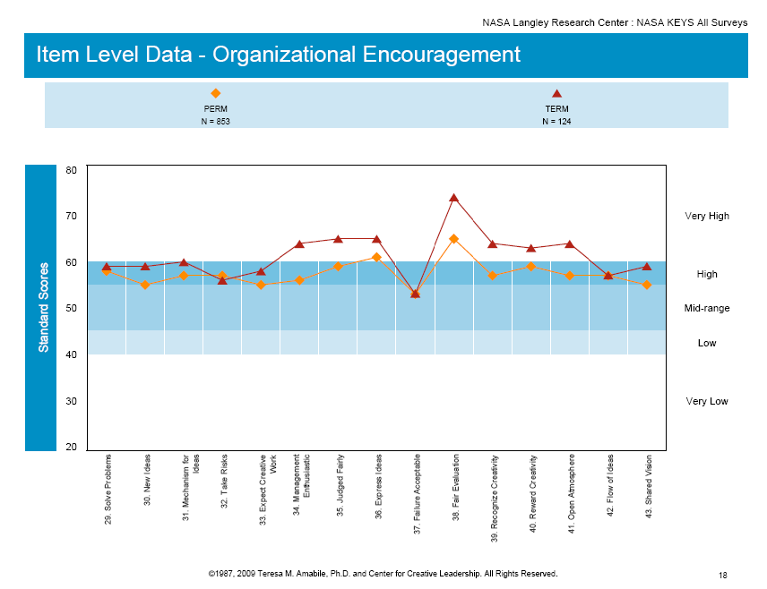

Slide 38
Key Findings (Level)
The higher you are in the organization, the more positive you see the climate
Non-supervisory Employees (Clerical, Secretarial and Support Staff, Technicians, Fabricators) rate “Realistic Workload Pressure” VERY HIGH (positive)
Directors are less willing to help each other (mid-range) than at all other levels
Directors, Deputy Directors and Branch Heads rate failure as more acceptable than Team Leaders and Non-supervisory staff
Budget was rated VERY LOW by Branch Heads

Slide 39
KEYS Data - Langley Research Center
LEVEL
Director N=26
Dept. Director N=42
Branch Head N=115
Team Leaders N=452
Non-Supervisory N=1,112

Slide 40
KEYS Insights
Vision: Where do we want to go?
KEYS Data: Where are we now?
Action Plan: How do we get there?
Notes:
KEYS provides a baseline where an organization currently stands in relation to their capacity for innovation
The data identifies pockets of excellence within organizations as well as areas that need to be improved
Facilitation Questions:
- Ask the original research question; “think of a time when you were at your most creative; what were the conditions that
existed that enabled that to occur?” People will tell stories that you can link back to the 8 factors assessed in KEYS.
- What obstacles do members of my work group face in their present environment?
- What “course corrections” can be made by utilizing the stimulants to overcome the perceived impediments to Creativity?
- What opportunities can be identified through this feedback, to help us take more effective actions?
To improve the management practices . . . . at ABC company
- What can I do?
- What can my work group do?
- What can the organization do?

Slide 41
What Drives Innovation?
“Leaders will get the most innovative results from their teams if they view their role as providing their teams with the environment they need to be effective, and then giving them the respect, responsibility, and freedom to do good work” PPS-SNAPSHOT:August 2011

Slide 42
DAC
Direction: Agreement on what the collective is trying to achieve together
Alignment: Effective coordination and integration of work so that it fits together
Commitment: Willingness to make the success of the collective (not just individual success) a personal priority

Slide 43
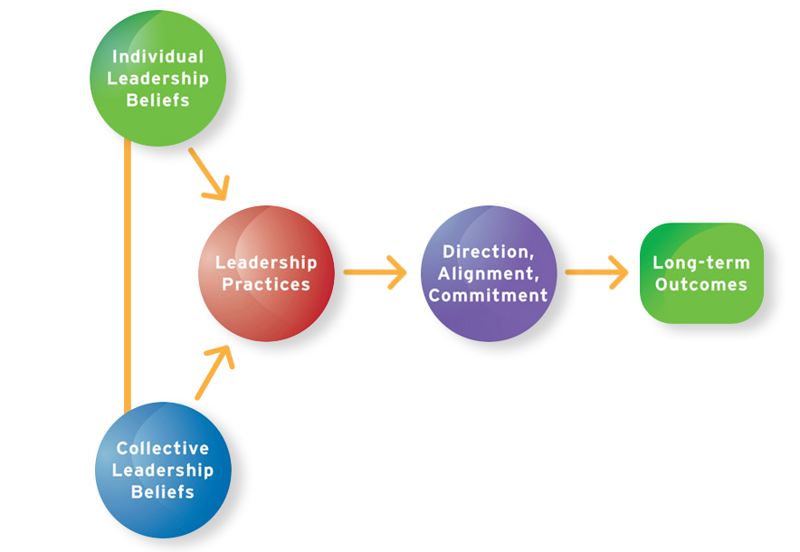
Leader’s Role in Generating DAC
Have
Produce
Impact
Equip people with skills to participate
Improve your own ability to participate
Create more leadership processes
Create better leadership processes
Pay attention to whether leadership is happening

Slide 44
Implications - Reflection
What questions do these data create?
Does KEYS data support the results of the FEVS and other information you know?
How to sustain a positive climate for creativity and innovation?
What might get in the way; how to prevent that from happening?
What role can leadership play at NASA LaRC to continue improving the work environment?
What leadership issues need to be addressed at the executive team level (Directors)?
When is it acceptable to put in a good work effort and fail?
What are the implications of staff protecting their territory?
How can “challenging work” and “freedom” be improved in the contractor employee population?

